Slide 1
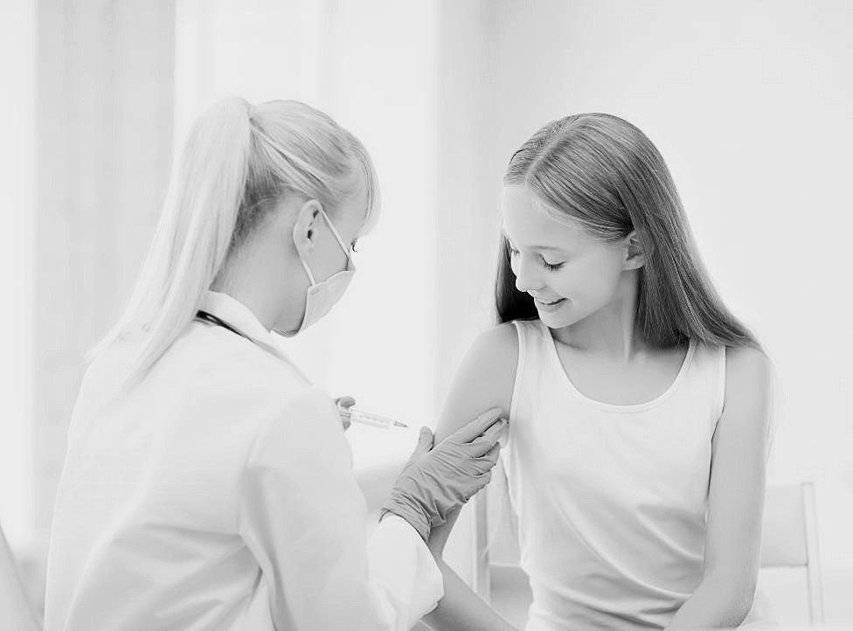

Rebuilding Trust
Reversing Ireland’s HPV Vaccination Crisis
Public policy & social research, Grand Prix

Slide 2
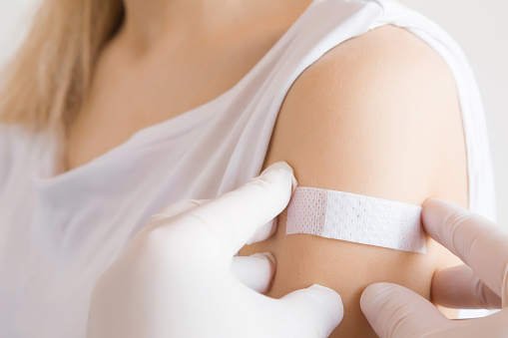
Context
Human papillomavirus (HPV): A common virus that can cause cancer.
420 Irish cases a year: 130 (preventable) deaths.
Vaccination introduced in 2010: all girls in first year of secondary school.
Initial 2010 research (qualitative & quantitative, mums, teens, twenty-something women, HCPs) very supportive.
A very positive start but only possible to see tangible reduction after 10+ years.

Slide 3


A virus passed by skin to skin sexual contact: vaginal, oral, anal.
Most common late teens to early 20s.
Approximately 80% of sexually active people will get HPV at some stage.
Most infections clear on their own.
Can lead to development of certain cancers, and very commonly, to genital warts.
Cervical Cancer
7th most common cancer; 4th for women.
Ireland near top of the global league table (1 in 115 women, 2013.)
6,500 treated for pre cancer of the cervix annually, 300 diagnosed with cervical cancer, 90 die.

Slide 4

Anti-vax activity
In 2015 Anti-vaccine lobby groups established: strong social media platform, targeting parents, striking personal accounts by “vaccinated girls”, distributing misinformation.
This lobbying activity, attributed to parental concerns about safety, resulted in uptake dropping to 72.3% (‘15/’16), and to 50% for first dose uptake in 2016/17. Concern it could hit 30% in 2017/18.
*Source: Corcoran, Clarke & Barrett (2018)

Slide 5
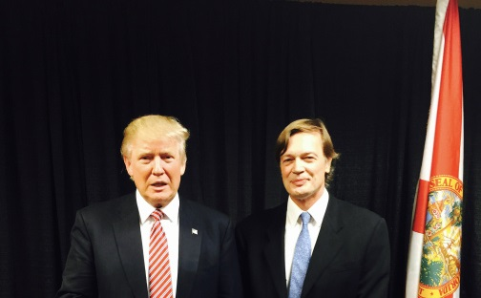
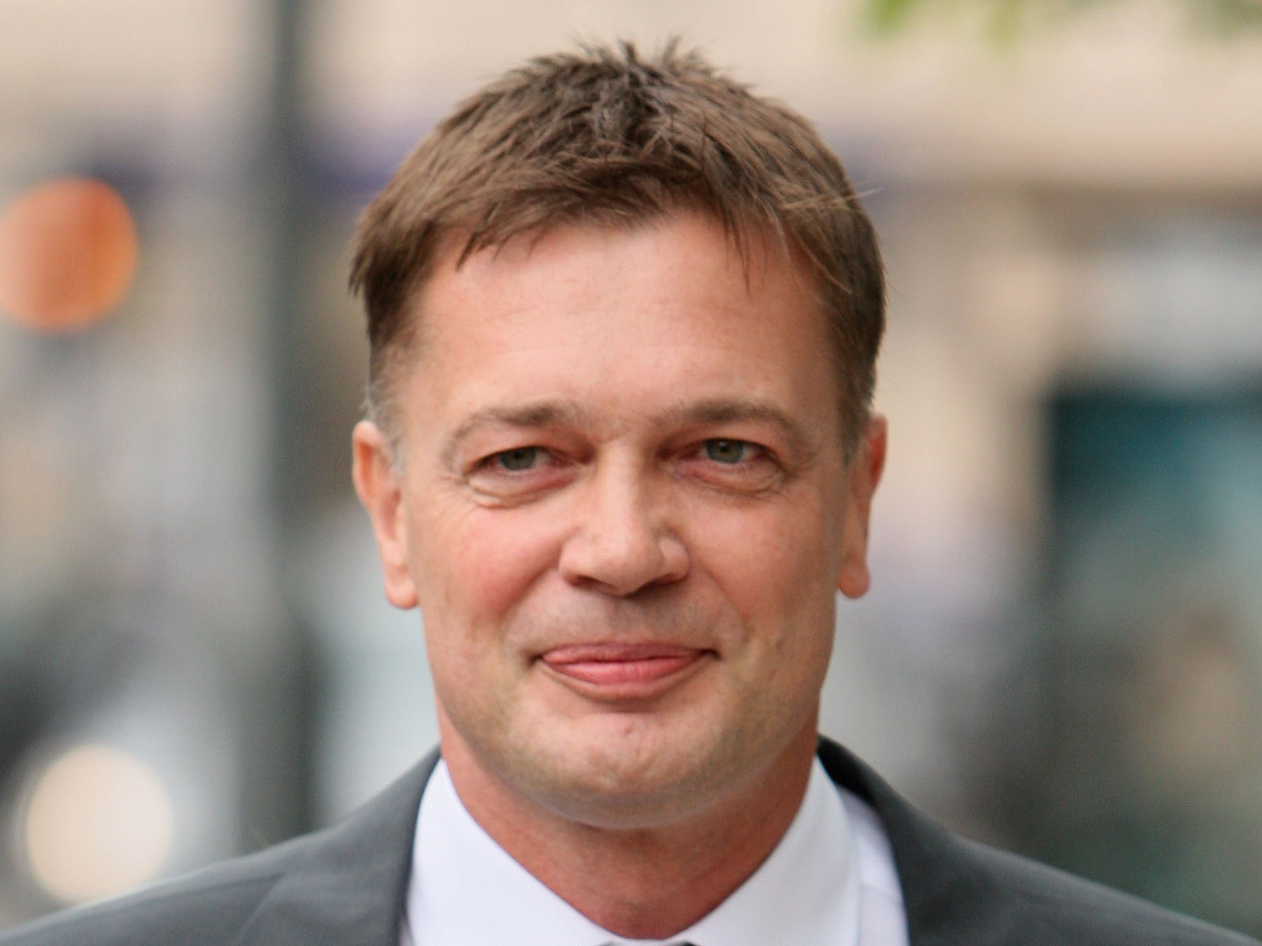
Anti Vaxxers?
Andrew Wakefield, 1998 MMR allegations, fabricated, discredited, struck off.
2016 President-elect Trump meets Wakefield, reiterates vaccine antipathy.

Slide 6
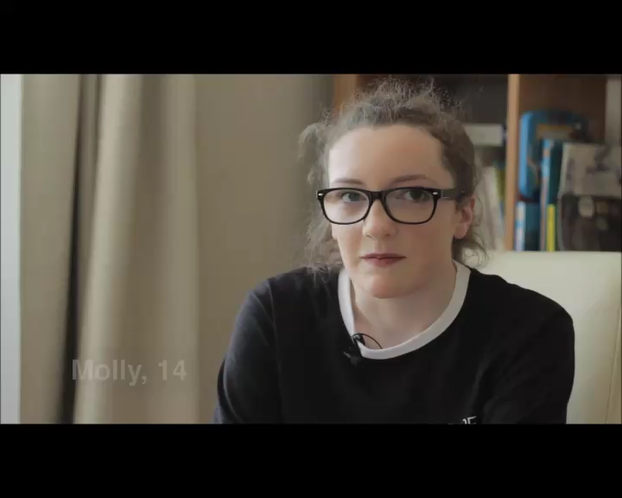
Google ‘HPV’ in 2016
+
10:1
-
Analysis of 2014 – 2017 tweets revealed an active campaign by Internet Research Agency (IRA) to amplify pro and anti-vax messages. IRA is the Russian ‘troll farm’ indicted* by Grand Jury on Feb 16th 2018 for manipulation of the 2016 US Presidential Election.
*Ref: Dept of Justice (District of Columbia): Conspiracy, Criminal Conspiracy, Fraud, Wire Fraud etc

Slide 7
Dramatis personae
MSD (Ian Pitcher & Dr. Janice Murtagh)
Our Clients
Our Clients Client
National Immunisation Office (HSE), Dr. Brenda Corcoran
The Vaccine
Gardasil (prevents 4 of the most common strains…70%+ coverage)
The Challenge
Locally: Herd immunity lost if vaccine coverage falls.
Globally: Domino effect….Denmark, Japan etc.
Our Team
Larry Ryan, Elsa Butler Rees, Rachael Joyce

Slide 8

Research objectives
Gain knowledge into parents’ perspectives of HPV and vaccination
Understand key drivers and barriers to vaccination
Inform future strategic action of stakeholders at public health organisations
Regaining parental trust.
Increasing vaccine confidence.

Slide 9



Qualitative phases
A first qualitative phase carried out in early 2017 served as a baseline marker. It consisted of eight, two-hour focus groups, with parents of girls in sixth class, and separately first year.
A second qualitative phase was carried out in late 2017, to review campaign developments and test material/initiatives. This involved six, two-hour focus groups, with mothers of first year students only.
Mainly mums: more health involved.
Some dads – phase one only.
Regional spread (Munster, Rural Leinster, West Coast.)
Social class spread.
Splitting naïve and experienced parents key.

Slide 10

Research design considerations
Groups consisting mainly of mothers were recruited on the basis of previous research suggesting mothers play a more dominant role in health-related decision making for the family.
Two groups of fathers allowed us to explore the role of the father and their level of input in the vaccination decision.
Separate groups of 1st time and 2nd time teen parents were recruited to get an overall sense of the differences between those who had gone through the vaccination process before and those who were new to it.
Parents of 6th class and 1st year were separately included in order to get a sense of the level of awareness of the programme prior to first year, as well as attitudes and perceptions of those previously involved.
Cognisant of potential regional and social class differences, a mix of these were also included.
Aware that rate of fall-out from the programme more elevated in Munster, parts of rural Leinster, and to the West of Ireland.
Parents were recruited without reference to views or behaviour in relation to the vaccine.

Slide 11
Group structure
A series of eight two-hour long focus groups was undertaken.
Group | Gender/Role | Social Class | First/Second Time Teen Parents | School Year | Location
1. | Female/Mothers | Middle | Second | 1st Year | Dublin
2. | Female/Mothers | Working | First | 1st Year | Limerick
3. | Female/Mothers | Farming | First | 1st Year | Mallow
4. | Male/Fathers | Middle | Second | 1st Year | Sligo
5. | Female/Mothers | Middle | First | 6th Class | Limerick
6. | Female/Mothers | Working | Second | 6th Class | Dublin
7. | Female/Mothers | Farming | Second | 6th Class | Sligo
8. | Male/Father | Working | First | 6th Class | Mallow
Additional Criteria
No control by attitude to/experience of the vaccine.
Aiming for a mix of schools/locations, rather than single school/ neighbourhood.
Excluded doctors, pharmacists and nurses (or their spouses) as well as journalists, PR, marketing, etc.

Slide 12
Research procedure
Living with teens
Parenting and its challenges
Adolescence
Spontaneous reactions
Stimulus Reviewed
Campaign & negative campaign response

Slide 13
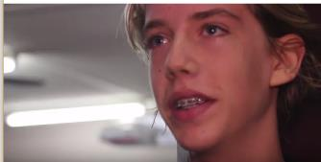

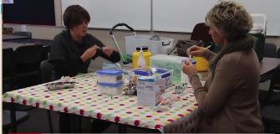
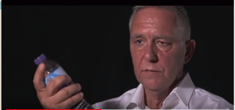
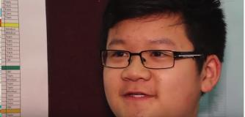
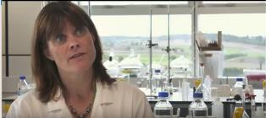
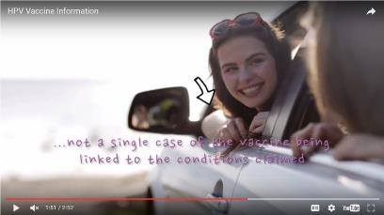
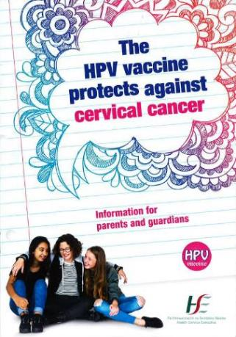
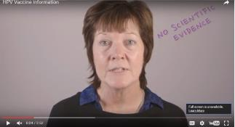
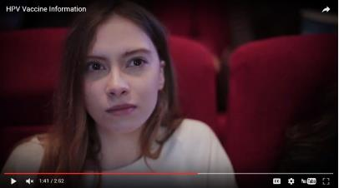
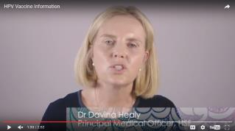
Inputs
Wide range of stimulus material: consent forms, information leaflets.
Extensive literature review distilled down into a range of claims, supports, articles, evidence from other countries: tested in rotation across various groups.
Also looking at advertising and comms used in markets including Britain, Australia, Canada.
Focus on HSE/NIO campaign and testing a range of approaches into phase 2.

Slide 14




Quantitative Phase
A quantitative stage was then conducted in early 2018 to measure and validate qualitative findings from the perspective of a nationally representative sample
1,002 adults aged 16+ were interviewed:
373 parents of an under 21 year old
340 parents of an under 18 year old
150 with a child aged 12 to 18.
The sample quota controlled by; gender, age, socio-economic status, all within region.
Interviewing was conducted face-to-face and in-home by trained members of the B&A field force.
More empathetic, personal.
Detailed assessment of respondent’s knowledge and understanding of HPV
Reactions to a range of perspectives of vaccination
Testing of supports, language, themes.

Slide 15

Adolescence

Slide 16

Trust
Shifting from vertical to horizontal axes of trust (from ‘parent to child’ to ‘adult to adult’ communication.)
Horizontal axis of trust
Vertical axis of trust
In the past we tended to trust those in higher positions, with more authority than us
Today we are more inclined to trust our peers – we want peer reviews for holidays, restaurants, movies etc.
In an era where there have been many scandals, and where the man in the street has been able to effect change: Trump, Brexit, water charges etc.

Slide 17
Vaccine typologies
Parents fall into a number of distinct types in relation to vaccination. Many waver between different modes. Pushing to decide rapidly can harden resolve.
Silent minority (/majority?)
Troubled and uncertain
Antagonists
Pragmatists
Believe in vaccination in principle
Less into social media
Generally assume it is in the common good and that most take part.
May or may not be aware of misgivings: some definitely are.
Assume side effects to be rare/unintended.
Doubts about programme management and speed.
May encourage daughters to participate or simply decide for them.
Wavering sceptics.
A substantial group.
Have significant misgivings and need more information.
Anxieties fuelled by speed of decision, daughters concerns, rumours and Facebook/social media.
Feel corralled into participation.
Many in wait-and-see mode.
Some have had first, won’t have second.
May be heavily Facebook lead.
May have heard of bad reactions locally: lethargy etc.
No smoke without fire: Paranoia.
Hostile to programme and feel it is designed to leave little time to question.
Well versed in Regret’s arguments.
Can be too embarrassed to back down from position adopted.
Moreso middle class
Moreso Dublin
Common rural too
More traditional/ balanced?
Broad Munster & West of Ireland
Lower middle/ skilled working
More likely working class.
Some less well educated
Can be quite anti-establishment

Slide 18
Underpinnings of vaccination perspective
A number of factors having a bearing on HPV perspective
Affluent
Less Affluent
More of-the-establishment
More questioning
Better educated
Basic education
Middle class
Working class
More rationally lead
More emotionally lead
More authoritative parenting
More consensual parenting
Low social media involvement
Higher social media involvement
Better health informed
Limited health knowledge
This is not to suggest that better educated, middle class parents are wholly supportive. Many are sceptical and as critical of elements of the programme and its administration. Some are more prepared to give the State the benefit of the doubt and assume shortcomings are unwitting.

Slide 19
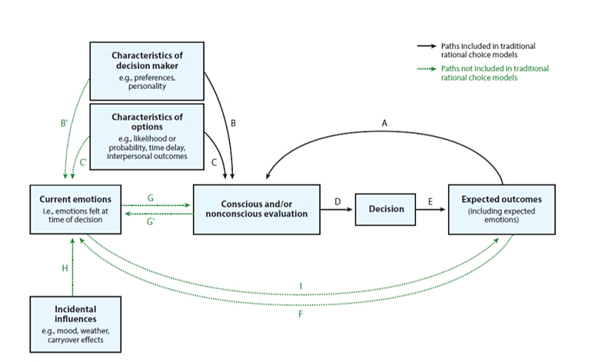

The influence of emotion on decision making
At the analysis stage we considered and applied a recently developed model, which aims to integrate the importance of emotion in influencing decision making.
“The emotion imbued choice model” Lerner et al (2015)
“Emotions constitute potent, pervasive, predictable, sometimes harmful, sometimes beneficial drivers of decision making” (Lerner et al, 2015)

Slide 20
Applying the theory
Lerner et al outline solutions to minimise emotional impact
Time delay
The simplest strategy for minimising emotional magnitude is to let time pass before making a decision.
Reappraisal
Reframing the meaning of stimuli that led to an emotional response
The dual-emotion solution
Counteract an unwanted decision effect by inducing another emotion (i.e. desire to protect rather than fear of the unknown)
Crowding out emotion
Saturating the decision maker with cognitive facts about a particular decision domain – noted as a significantly less effective strategy
For these to be effective it is necessary for the influencers of the decision (parents or teachers) to be on the same side as the proponents of the vaccine.

Slide 21


Key outcome:
“I’d rather let her make up her own mind”
The decision around HPV vaccination emerged as a difficult one for parents – one they (wrongfully) perceived as a choice between exposing their daughters to the risk of debilitating side effects, or developing cancer. Also common amongst parents were;
  Doubts around the effectiveness of the vaccine,
  Perceptions of Ireland as a vaccine trial “scape goat”,
  Gender-targeting: ‘picking on women’.
  Fears of extreme side effects,
  believing their children are too young to be affected by the virus.
Only 27% said they fully understand HPV. 80% of those with a daughter under 18 said that understanding HPV better would influence them to consider the vaccine.

Slide 22

Key outcome:
“I’m suspicious”
There were significant timing issues impacting on parents’ decision-making and resulting in online searches and false information…
No parent network (start of secondary school.)
Start of first year secondary school, causes difficulty for parents: too much else going on. A time of upheaval for daughters; parents often accede to requests to opt-out.
Turnaround from receiving vaccine information to consent too short (2 days): scepticism and rushed decision-making – going online for information (heavily negative, and inaccurate.)
Over half (53%) with a daughter under 18 years are influenced about the HPV vaccine by what they’ve heard online/in the media.

Slide 23

Key outcome:
“Teacher says….”
A perceived lack of buy-in or support from key figures: the GP, schools, teachers.
GP not involved, should be.
Run by Department of Health; Education has no involvement.
Schools not engaged with the programme; parents question its legitimacy.
Vaccination administration in schools described as chaotic and stressful ….“crowding, screaming, crying and fainting” commonplace.
Of those with a daughter under 18, 71% said they would only consider a HPV vaccine if their GP recommended it, while 78% might consider the HPV vaccine if more information from school.

Slide 24
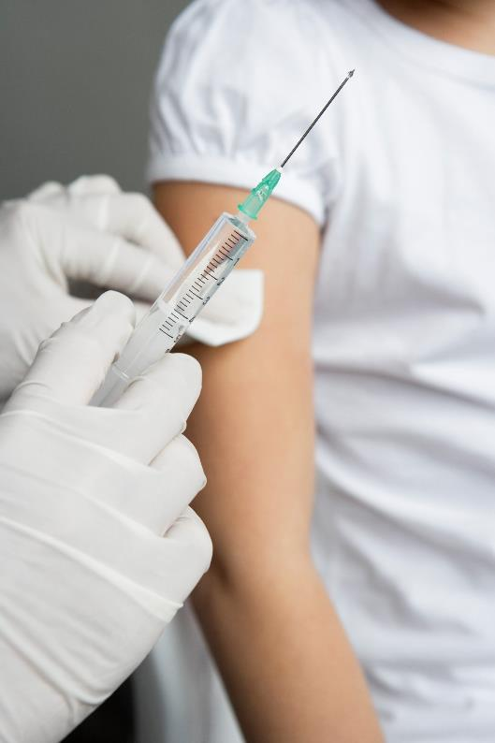
Key outcome:
“I don’t believe them”
Official information materials impersonal, overly officious, raised suspicions. Online only.
  https://www.youtube.com/watch?v=onf5tiSa-IU
Many feel list of side effects not exhaustive – provokes mistrust that serious issues being hidden.
Lack of reference to recommendation by international and local health authorities a mistake.
Lobby groups online video materials more emotive and engaging.
Media fanning the sparks: TV3, local radio.
77% would consider a HPV vaccine for their daughter if other developed countries had a similar programme.

Slide 25

Key outcome:
“Where’s the emotion?”
A perceived absence of response to lobby groups from the ‘authorities’.
Media dominated by lobby groups.
‘False balance’: is there truth to claims?
Lacks transparency, “high handed: a cover up?
Non-use of TV ads (unlike speeding, texting, obesity etc.)
Of those with a daughter under 18, 78% said they would consider a HPV vaccine if there was a state campaign to promote it.

Slide 26
Key recommendations
1.
Address parental misconceptions and fears by providing comprehensive and emotionally engaging information.
6.
Enhance schools’ and GPs’ engagement with the programme through information and training, to promote parental trust in the vaccine.
2.
Reference supporting national and international health authorities (e.g. World Health Organisation) on informational material.
5.
Generate a strong response to anti-vaccine lobby groups, by bringing together relevant organisations and politicians.
3.
Allow parents longer for decision-making by introducing information material in 6th class.
4.
Increase the volume of positive HPV sentiment online and on TV. Develop content which allows the voice of advocates to be heard (parents, families, people with HPV-related cancers).

Slide 27
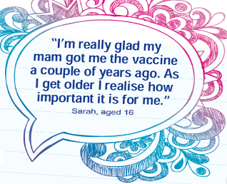
Actions
Education
To address parental misconceptions and fears, information materials revised to be fully comprehensive.
Quotes from vaccinated girls and their mothers added to enhance emotional engagement, and endorsement from international and local health authorities (e.g. World Health Organisation) referenced.
These revised materials now distributed during 6th class to allow more time for decision-making.
Primary/secondary curriculums now aligned, teachers on board.

Slide 28

Actions
HPV Stakeholders
For a united front, B&A’s research was presented initially to the key medical bodies and then to industry, media, medical professionals and to 35 charity groups, leading to the formation of the HPV Vaccination Alliance – a multi-member body, speaking with a wholly aligned voice.
The 2017/18 HPV vaccination programme was launched by then Minister for Health Leo Varadkar, supported by senior politicians. Vaccination programme prioritised.

Slide 29

Actions
GP Endorsement
Collaboration with primary care instigated and a training programme on HPV vaccination was implemented.
Fact sheets and posters sent to all GPs to prompt advocacy.
Close collaboration with medical representative groups.

Slide 30

Actions
School Engagement
To increase schools’ engagement with the programme, frequent presentations and newsletters to teachers, teachers’ unions and parents’ associations.
Primary/secondary curriculum alignment (unique).
Enhanced administration of programme in schools.

Slide 31

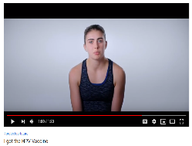
Actions
Positive Public Sentiment
To address the lack of positive HPV sentiment online and in the media, an impactful TV and online campaign was launched featuring vaccinated girls.
  “I got the vaccine”
  #ProtectOurFuture
  https://www.youtube.com/watch?v=CwReNjXp-CQ
Variety of online initiatives focused on girls and mums.

Slide 32
Research Impact
The research-informed strategic actions taken resulted in a number of positive outcomes.
First dose uptake of the HPV vaccine increased to 61.7% in 2017/18 and to 68% in 2018/2019, with further increases expected. This despite projections (when at 50%) of a potential decline to below 30%, based on experience in countries with similar agitation, such as Denmark and Japan.

Slide 33
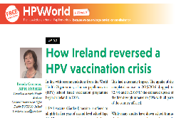
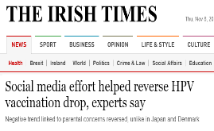
Online sentiment shift
2015/16
2018
10:1
+
-
1:12
-
+

Slide 34
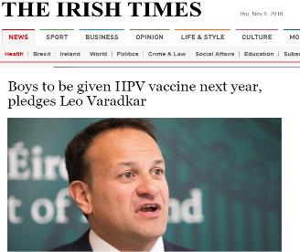
Research Impact
Taoiseach announces extension of programme to boys from September 2019.
Substantially boosts the level of potential herd immunity.
Seen as a vital step for gender equity.
Boys can be carriers but can also experience a number of serious (largely fatal) cancers: head, neck, anus.

Slide 35
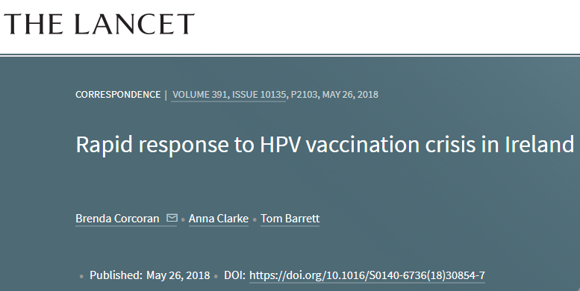
“
Forming powerful cross-sectoral alliances has led to this rapid improvement in vaccine uptake, which contrasts with what has been seen in other countries that have had similar steep declines in vaccine uptake, such as Japan and Denmark.
It is vital that this positive momentum is maintained to decrease morbidity and mortality from cervical cancer.
The Lancet

Slide 36

Result
The dramatic collapse in the rate of HPV vaccination in 2015/2016 resulted from concerted global and local social media agitation, which threatened to undermine the entire programme.
B&A undertook an extensive research programme to understand issues, review programme positioning and develop a more compelling basis for parental buy-in.
This research resulted in strategic and system changes, precipitating rapid recovery and at a much faster pace than seen in other targeted countries, and thus contributing to efforts to decrease morbidity and mortality from HPV-related cancer in Ireland.

Slide 37
Thank you.
www.banda.ie
Milltown House Mount Saint Annes, Milltown Dublin 6 - D06 Y822
+353 1 205 7500 | www.banda.ie

