Slide 1
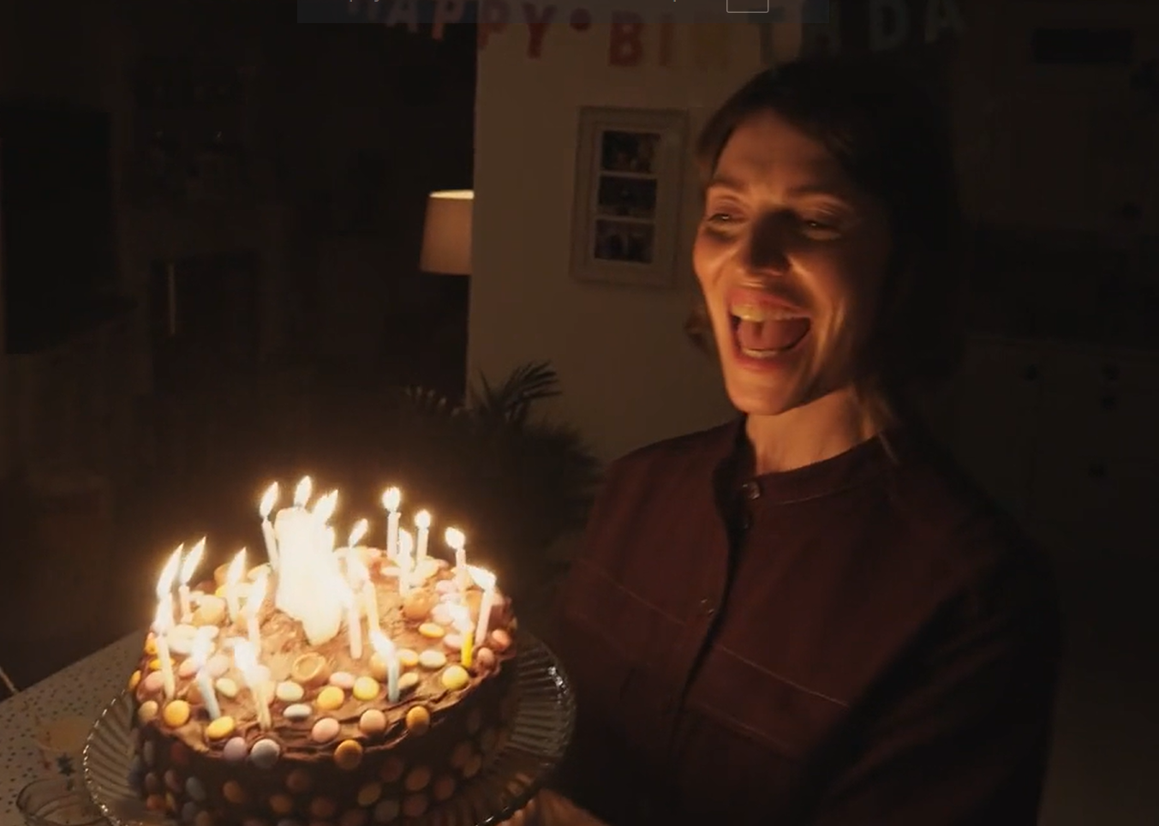

Every Second Counts
Reframing Stroke as the Emergency It Is
Category: Advertising Research
1
Notes:
We are delighted to be here today. This project was particularly meaningful; one we will all remember for a long time to come.
Every second counts when someone is having a stroke, it’s a medical emergency and urgent treatment is essential – most of us know this…….
……Yet this truth wasn’t always translating into immediate action.
This is the story of how we used research to understand that hesitation and turn it into action.
.

Slide 2
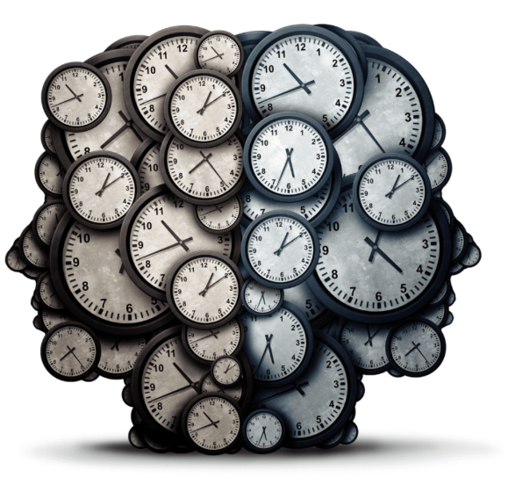

The Problem
73%
58%
Notes:
Stroke is the third leading cause of death in Ireland, and the leading cause of adult neurological disability. The Irish National Audit of Stroke (NAS) found that the proportion of patients reaching hospital within the treatment window was falling significantly. The reasons for delays in getting to hospital within this window were unclear. We set out to understand what was happening between recognising symptoms and taking action.

Slide 3
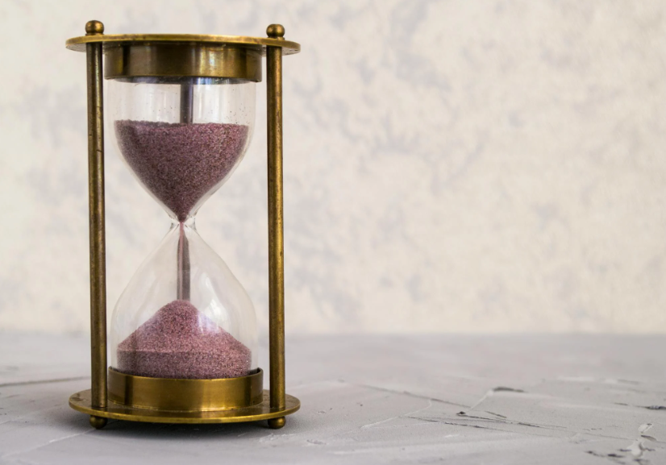
Why Research Was Needed
We couldn’t ask people to act without understanding why they wait.
Notes:
We wanted to uncover why people might hesitate seeking care, and how to communicate the urgency of acting the moment stroke symptoms appear. We took the time to explore every hesitation and every moment of doubt.

Slide 4
Our Framework
Biopsychosocial Model
Biological
The symptoms
The causes
Social
Psychol-ogical
Perceived seriousness
Prevalence
Perceived susceptibility
Societal and social influence
Notes:
We applied a biopsychosocial framework to our thinking, design, analysis and the recommendations for this new campaign, not because it is hard to say and sounds impressive (when said correctly), but because stroke knowledge and stroke response is shaped by biological (the symptoms, the causes), psychological (perceived seriousness and susceptibility), and social factors (culture) simultaneously.

Slide 5

7 Phases - Rigorous & Robust
1
2
3
4
5
6
7
A National
View
Ethical
Approval
Assumed
Experience
Lived
Experience
Creative
Testing
Creative
Tweaking
Campaign
Analysis
Notes:
While the campaign’s purpose was to emphasise speed of action, our research demanded the opposite, a deliberate, rigorous exploration of why people hesitate, how decisions unfold in real time, and what truly motivates someone to act in a moment of crisis.
Through a two-year, multi-phase research journey, we explored both public knowledge and the lived experience of stroke survivors and carers. We combined national quantitative data with deep qualitative work.

Slide 6
A National View
- Our Benchmark
1
We identified gaps in awareness, the generational differences in confidence, and likelihood to act.
This informed early creative and media strategy.
Notes:
This was our benchmark. A nationally representative survey measuring knowledge, awareness, perceived seriousness, and how people would act for themselves or a for someone else. We identified the gaps in awareness, the generational differences in confidence, and likelihood to act, this helped to inform the initial media and creative briefs and strategy.

Slide 7


Ethical Approval
1
2
Ethical approval wasn’t a formality, it shaped how we designed and conducted every stage of the research.
Notes:
Because we would be talking with stroke survivors and carers and exploring potentially distressing experiences, ethical approval was essential. It signalled respect and care to participants, and it shaped how we recruited, questioned, and supported people throughout the research

Slide 8
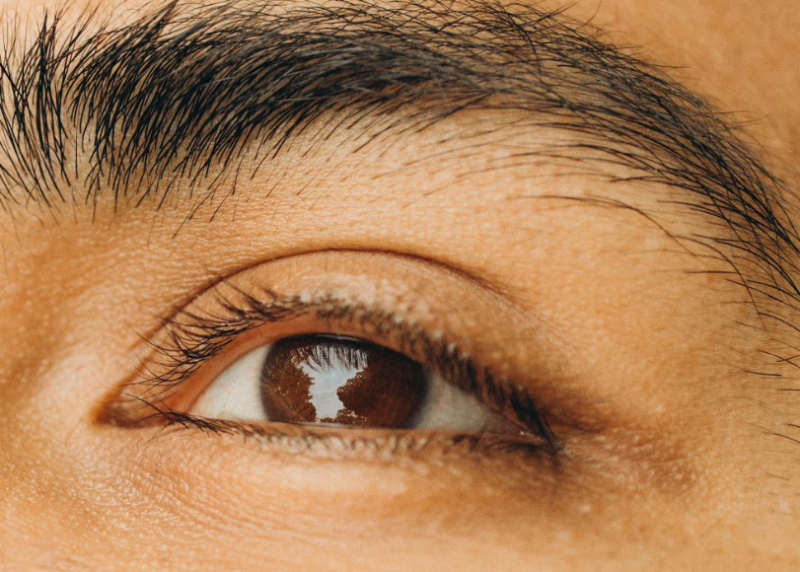
Assumed & Lived Experience
1
2
3
4
These phases revealed the
Optimism Bias
Social Fears
and Cultural Stoicism
that can delay hospital arrival.
“Me, stroke? Never. What are you talking about?”
Notes:
We conducted focus groups with a cross section of the public to assess the knowledge regarding the severity of stroke and the immediate actions required.
Once we received ethical approval, we partnered with Tallaght Hospital Group to recruit stroke survivors and carers. We conducted in-depth interviews capturing raw, personal stories of hesitation and hindsight. These revealed the optimism bias, denial, and cultural stoicism that can reduce vigilance, delay recognition of signs and ultimately hospital arrival.

Slide 9
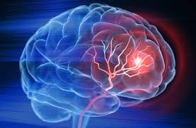
Insight
People take stroke seriously - just not personally
(Not Me Fallacy)
People will wait and see and because they don’t fully understand that the urgency of their response directly impacts the outcome.
Notes:
This was the breakthrough insight
People do understand that stroke is serious.
What they don’t believe emotionally is that it applies to them, right now. Many assumed they needed multiple symptoms before acting. Cultural stoicism (“I’ll be grand”) and embarrassment frequently overrode instinct. Others worried about wasting hospital time.
Hesitation reasonable in the moment until, in hindsight, it became life-changing.

Slide 10
What We Needed to Do
Biological
(Educate)
One symptom is enough.
It’s not just old people.
Social
(Cultural Stoicism)
Seeking help ASAP is the correct thing to do.
Psychological
(Optimism Bias)
It’s prevalent.
Don’t underestimate the risks.
Don’t wait and see.
A stroke is a medical emergency where you can play a vital role in the outcome.
Notes:
At the end of Phase 1-4 we had clear recommendations for the campaign messaging and direction (using our BioPsychoSocial framework).
People needed to here that
One symptom is enough, - and there are more symptoms than Face, Arms, Speech
Stroke can happen to anyone – its not just old people
Calling 999 is never overreacting – they have specific protocols for suspected Strokes
Don’t wait and see. Every second counts and you can play an active role in the outcome.
We needed to get through to people that every second counts in preventing stroke damage, a focus on the irreversibility of time.

Slide 11
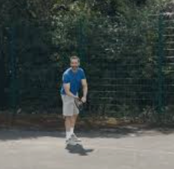
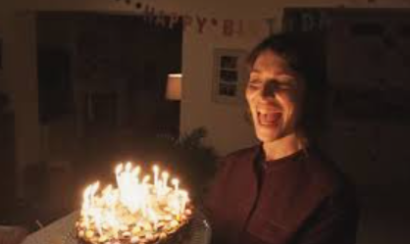
Creative Testing & Tweaking
1
2
3
4
5
6
This gave us clear, evidence-based recommendations to address the wait and see behaviour, by
Showing moments of hesitation
Emphasising the speed of brain damage
And using diverse, everyday scenarios and age groups to subvert stereotypes
Notes:
Three creative routes were rigorously tested through qualitative testing, including direct involvement from the stroke survivors and carers, to assess what genuinely built confidence, challenged optimism bias, and drove action.
This gave us clear, evidence-based recommendations to address the wait and see behaviour that existed, by showing the moments of hesitation people feel before recognising stroke, emphasising the speed of brain damage, and demonstrating, by using diverse, everyday scenarios and age groups to subvert stereotypes.
Although the initial plan was to proceed with a single scenario, our further creative interrogation recommended that two scenarios be included in this campaign. This approach gives us the opportunity to address a wider range of biases, including gender and age, and to move away from these stereotypes.

Slide 12
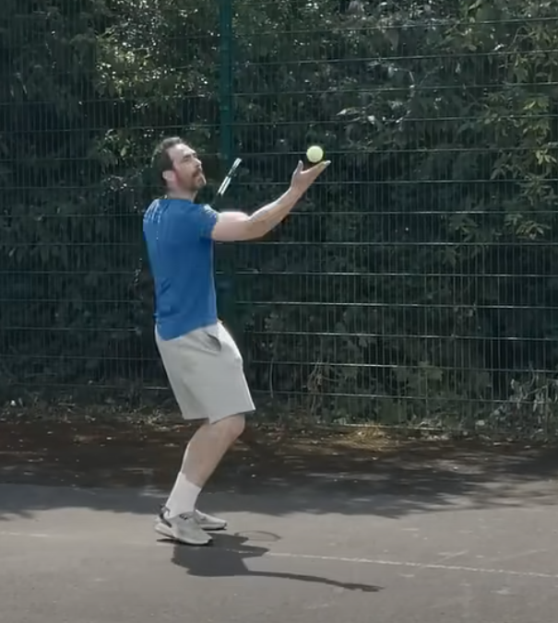
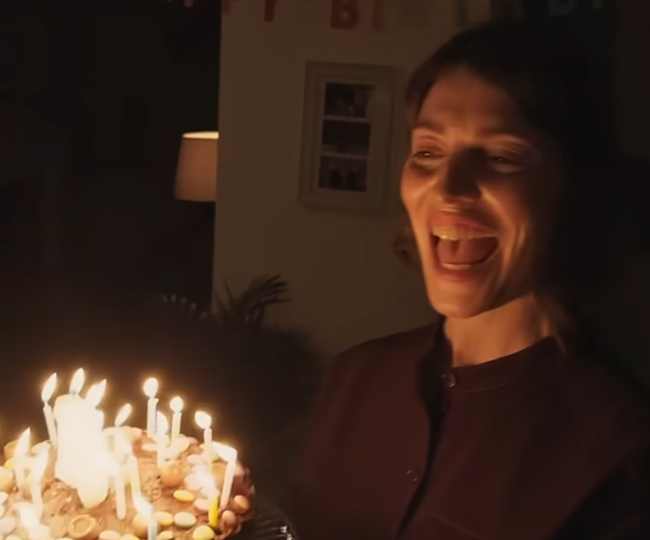
Impact
Confidence to act
Misconceptions
Activated stroke calls
Notes:
The campaign was launched in September 2025, with widespread promotional activity, and an ongoing campaign including two prominent TV ads and a radio ad, among others.
Early post-launch tracking showed statistically significant shifts in both knowledge and attitude, and more recent tracking shows further increases.
People feel more confident about what to do if they suspect a stroke, the immediate action required (we saw shifts of 7-8 percentage points after just the first month).
They are less likely to believe stroke only affects older people.
And critically, we saw behaviour change, with activated stroke calls increasing (up 7 percentage points in the period immediately following the campaign launch).
This told us the campaign wasn’t just being noticed, it was changing readiness to act.
This is a three years plan and this is only the start.

Slide 13
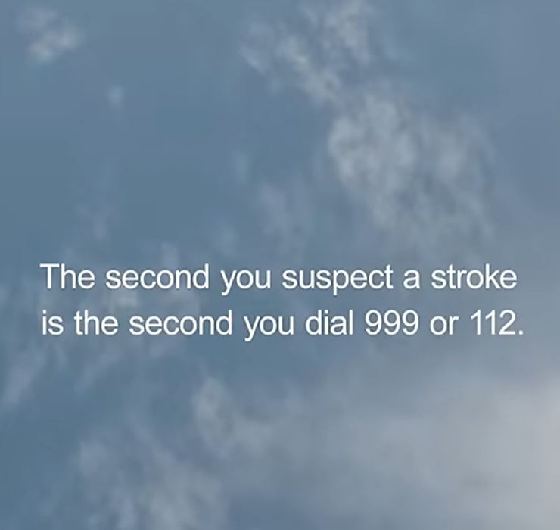
Thank You
Our deepest thanks to the stroke survivors whose lived experience guided this work. Without them, this campaign would not have the same authenticity and real-life impact.
Notes:
Thank you – to the team in Core Research, especially, Naomi & Berke, the HSE Communications team for their ongoing partnership, the Stoke specialists in Tallaght University Hospital for their education, collaboration, driving the ethical approval and supporting the inclusion of Stroke Survivors, and Publicis Dublin for listening to our feedback.
This work was shaped by stroke survivors, carers, and community partners and without them, it wouldn’t have the same impact.
And remember: Every Second Counts when you Suspect a Stroke

