Slide 1


An Post Delivering for tomorrow
Insights for An Post’s B2B eCommerce Transformation
Deirdre Kelly & Denise Price

Slide 2
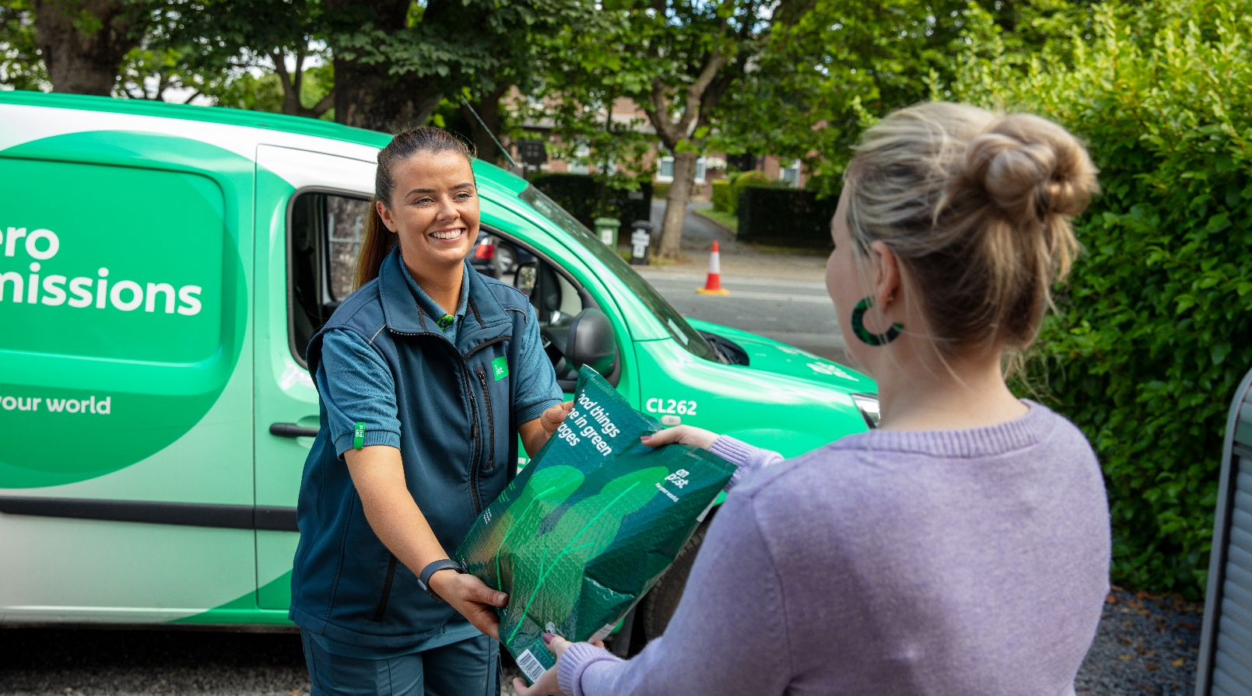
Delivering for Tomorrow Insights for An Post’s B2B eCommerce Transformation
The Challenge
The Approach
Key Findings

Slide 3
Delivering for Tomorrow Insights for An Post’s B2B eCommerce Transformation
The Challenge
The Approach
Key Findings
Mission critical transformation enabling relevancy and business sustainability for growth
Deep insights needed for:
Business customer acquisition and retention
Thought leadership positioning
Marketing insight development
Understand relevancy of e-commerce propositions
Independent credible data supporting SME insights

Slide 4
Delivering for Tomorrow Insights for An Post’s B2B eCommerce Transformation
The Challenge
The Approach
Key Findings
Continuous feedback and collaboration loop between consumer and SME research & teams through 2 trackers
SME: effectively communicate expertise
Consumer: behaviours and preferences & provider satisfaction
Actively cross-pollinate insights, offer flexibility, deliver stakeholder needs,

Slide 5
Delivering for Tomorrow Insights for An Post’s B2B eCommerce Transformation
The Challenge
The Approach
Key Findings
KPIs measured
An Post is an integral part of Irish eCommerce
Data to build An Post expertise and B2B service improvements
Consumer satisfaction delivers business satisfaction & growth
Actionable market intelligence

Slide 6
Delivering for Tomorrow Insights for An Post’s B2B eCommerce Transformation
The Challenge
The Approach
Key Findings
Mission critical transformation enabling relevancy and business sustainability for growth
Deep insights needed for:
Business customer acquisition and retention
Thought leadership positioning
Marketing insight development
Understand relevancy of e-commerce propositions
Independent credible data supporting SME and consumer insights
Continuous feedback and collaboration loop between consumer and SME research & teams through 2 trackers
SME: effectively communicate expertise
Consumer: behaviours and preferences
Actively cross-pollinate insights, offer flexibility, deliver stakeholder needs,
KPIs measured
An Post is an integral part of Irish eCommerce
Data to build An Post expertise and B2B service improvements
Consumer satisfaction delivers business satisfaction
Actionable market intelligence

Slide 7
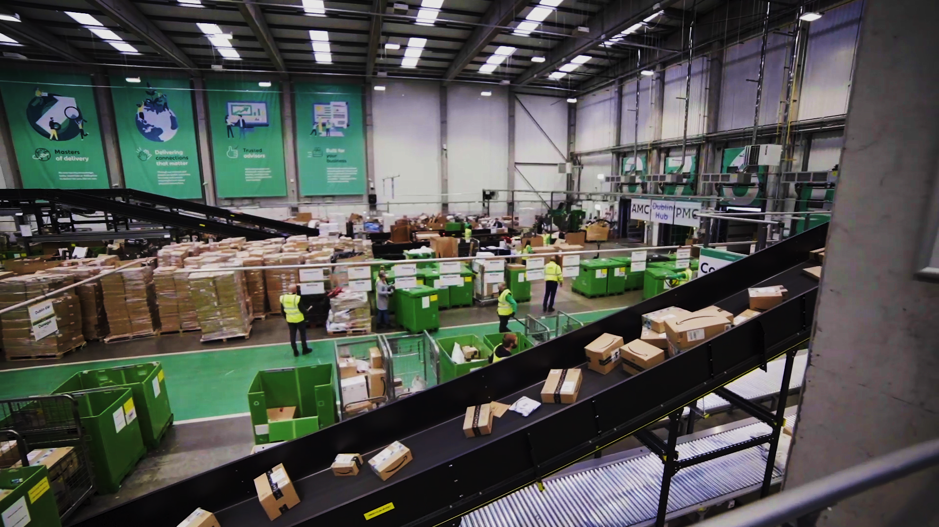
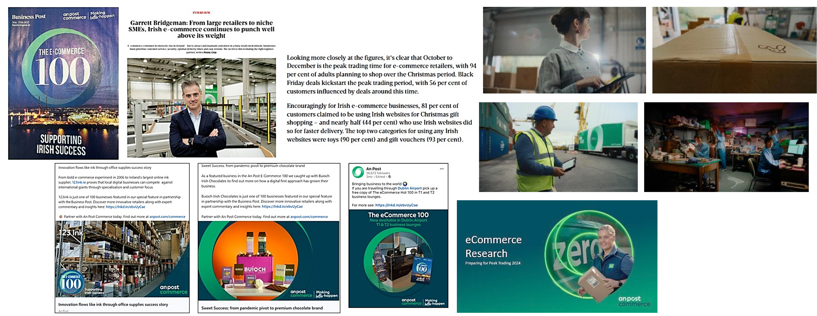
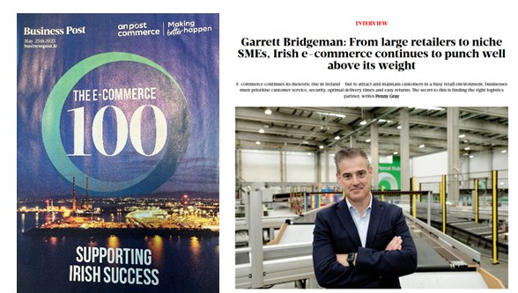

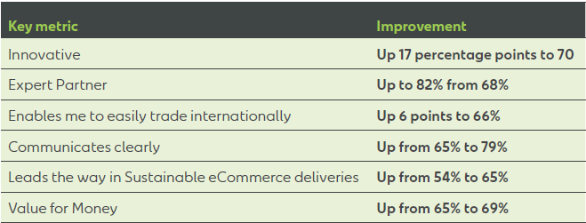

Research Impact
Business Growth
Campaign Development
PR & Thought Leadership
Business growth
New local and global clients & partnerships
Positioning An Post as the expert business partner to eCommerce SME’s
Data-powered PR activities and Thought Leadership

Slide 8
THANK YOU
NAME:
Deirdre Kelly
DETAILS:
Deirdre.Kelly@Ipsos.com

