Slide 1
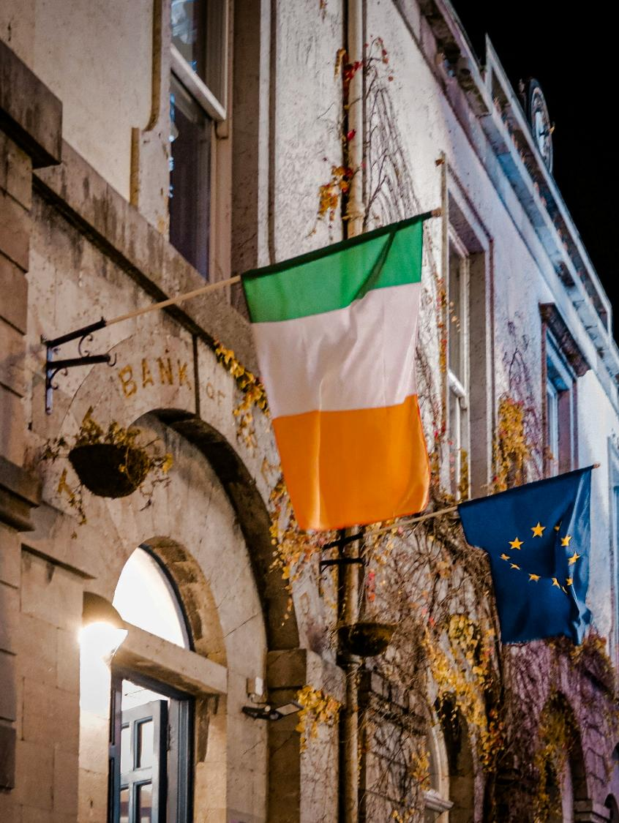


Giving the People of Ireland a Voice
Research Excellence Awards
Submission for: Public Policy & Social Research
Submitted by: RED C Research; John Rogers & Richard Colwell
Client: An Coimisiun Toghchain

Slide 2
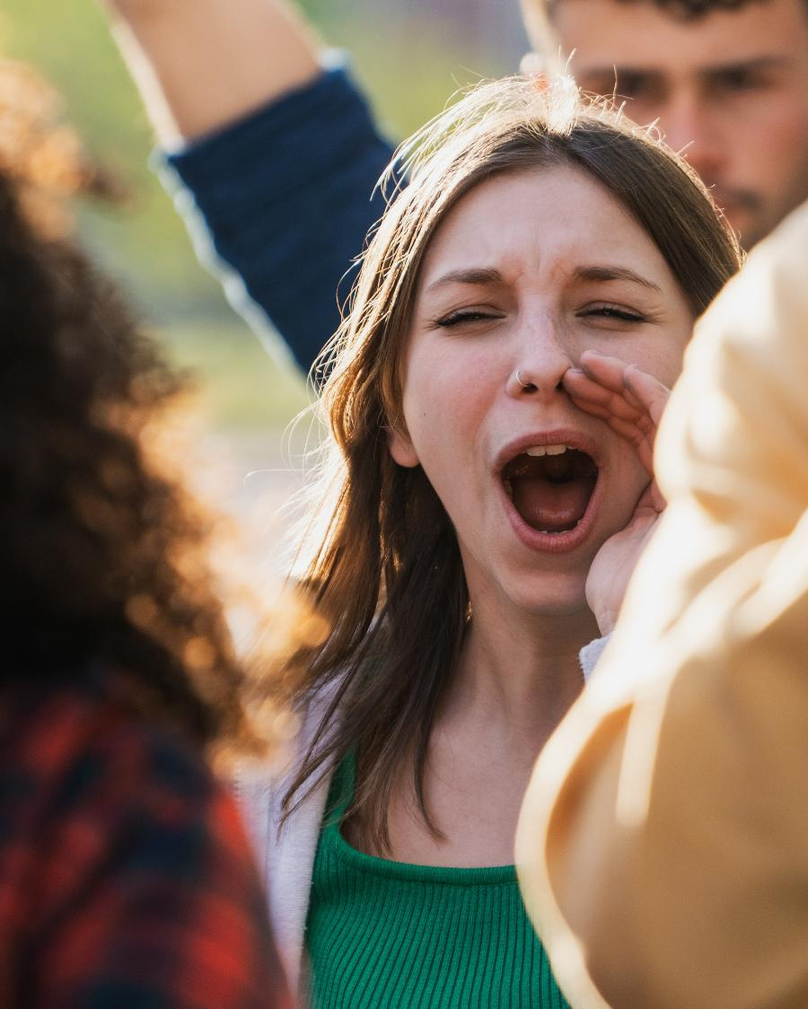

The need for a Public Voice
National Election and Democracy Study (NEDS) show how well democracy is working, what’s going right, what’s going wrong, and what needs fixing, based on real feedback from voters.
Most countries have run these studies for decades.
Ireland hasn’t, which means voters haven’t had a consistent way to be heard.
Working with the Commission we systematically gathered and analysed public opinion and voter experiences, feeding into the NEDS programme across three elections throughout the year.
Giving the people of Ireland a voice.

Slide 3








The NEDS programme serves a crucial democratic function for Ireland
Provide a detailed picture of voter attitudes and behaviour
Create a reliable, long-term data record
Improve electoral policy and democratic practice
Strengthen accountability and transparency
Support evidence-based journalism and public debate
Enable international comparison
Fuel academic research and teaching
Bring citizens’ voices into democratic evaluation

Slide 4

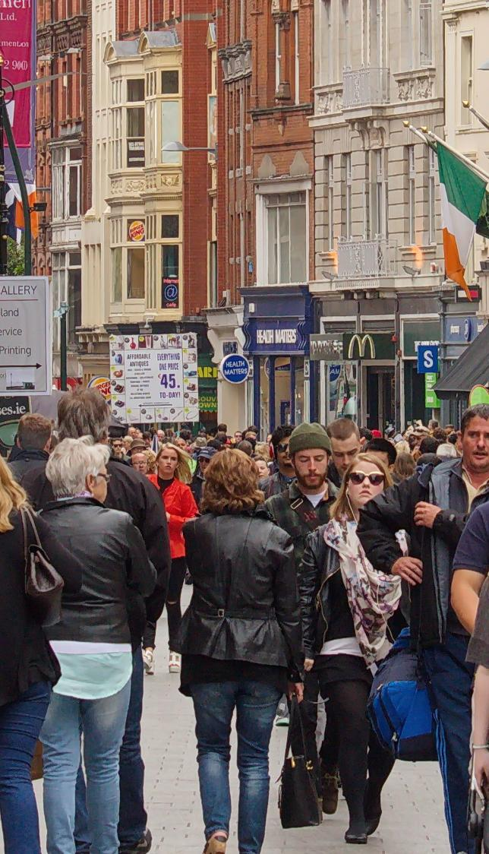
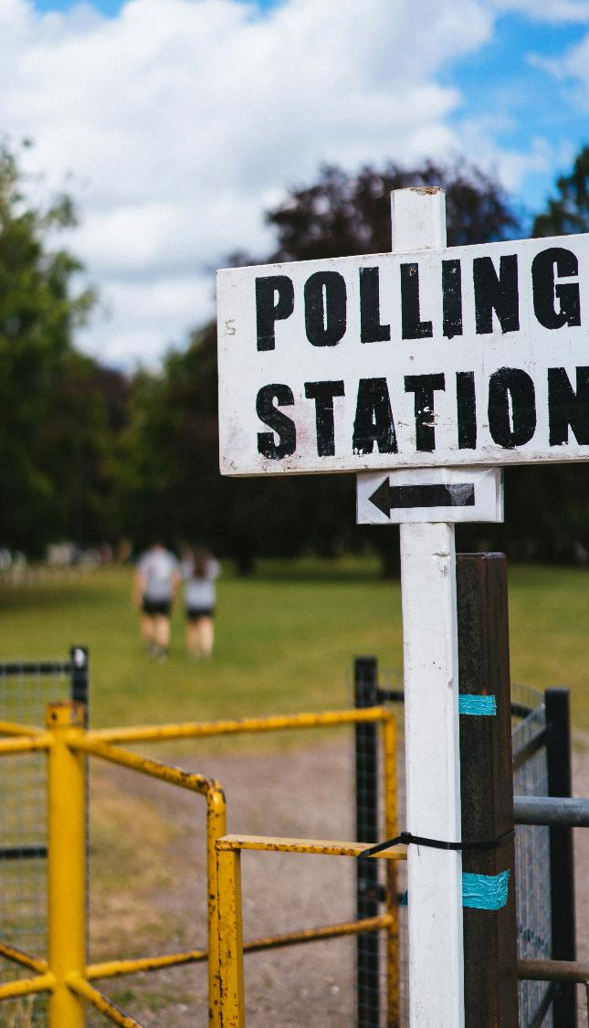

How we worked with the Commission
Care and Family Referendum
(Pre-Election)
Local & European Elections
(Post Election)
General Election
(Post Election)
2000 interview mixed mode approach of matched samples (n-1000 online and n=1000 x25 min telephone interviews).
A robust n=3045 respondents took part in this extensive 30 min online study, conducted immediately after the election with 1000 completed in 3 days
Face to Face random probability sampling of more than 1400 voters in 287 electoral districts conducted in wintery conditions post election, plus a matched sample online.

Slide 5
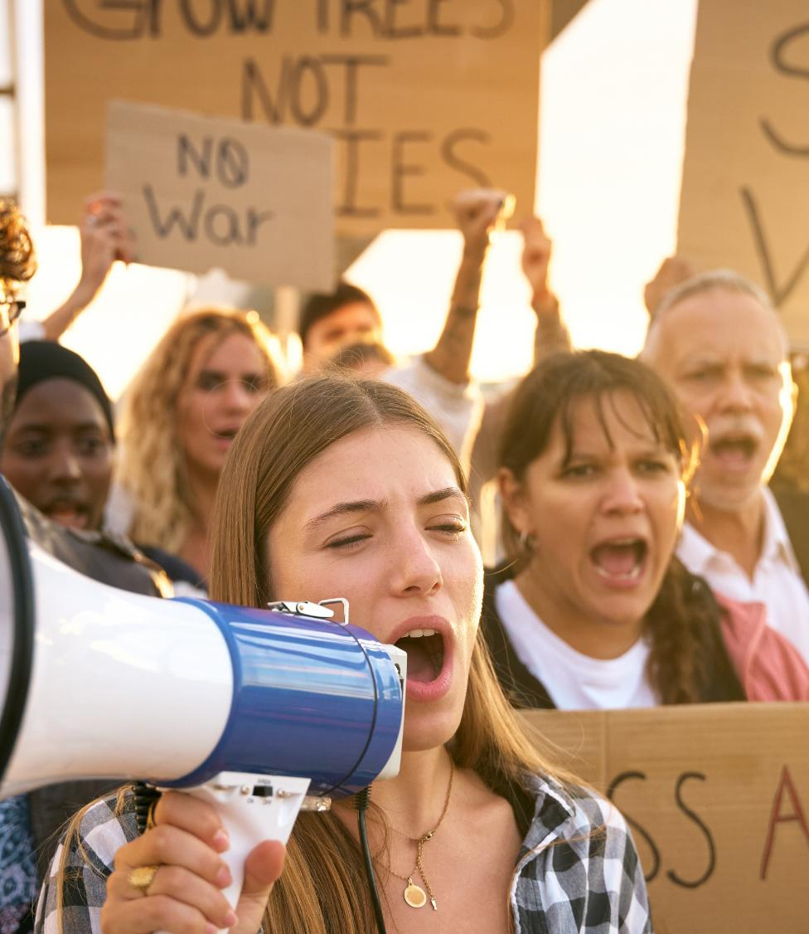
So what did this extensive series of research deliver?

Slide 6
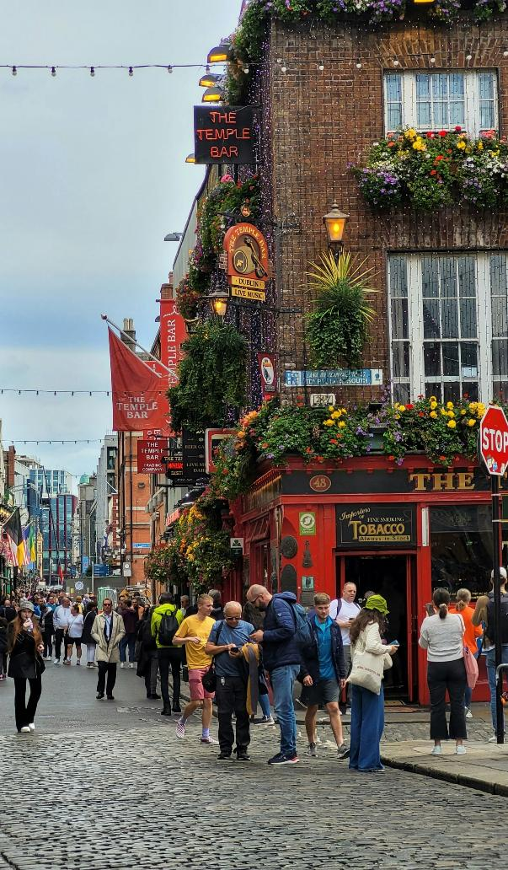
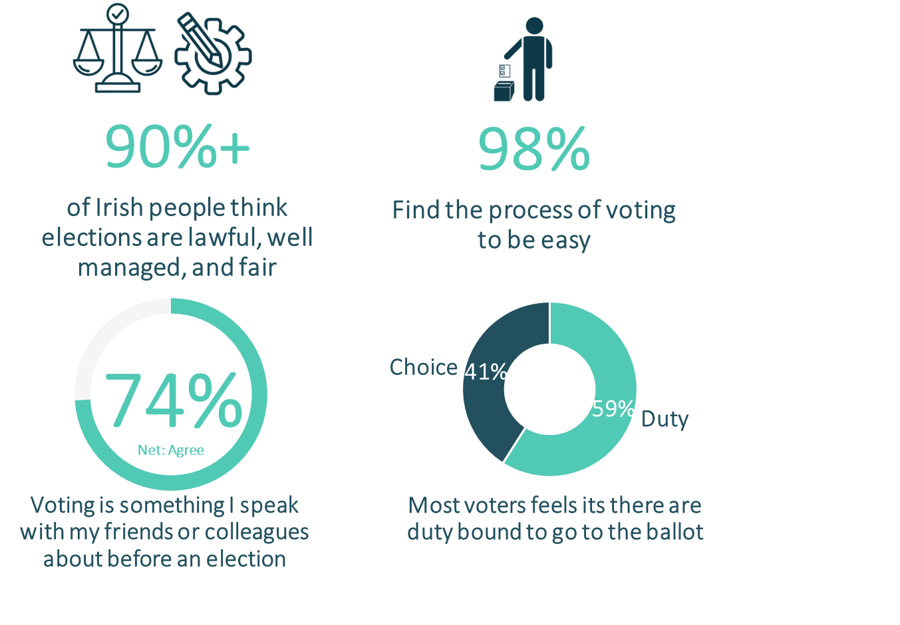
Uncovered that people are confident that electoral events in Ireland are run well & have high voter efficacy

Slide 7
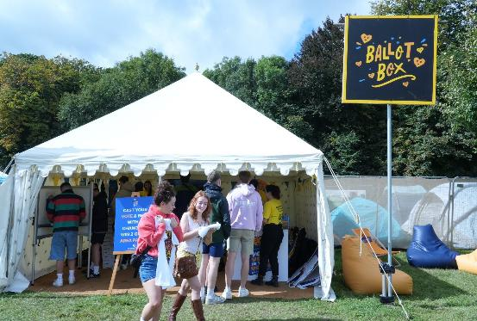
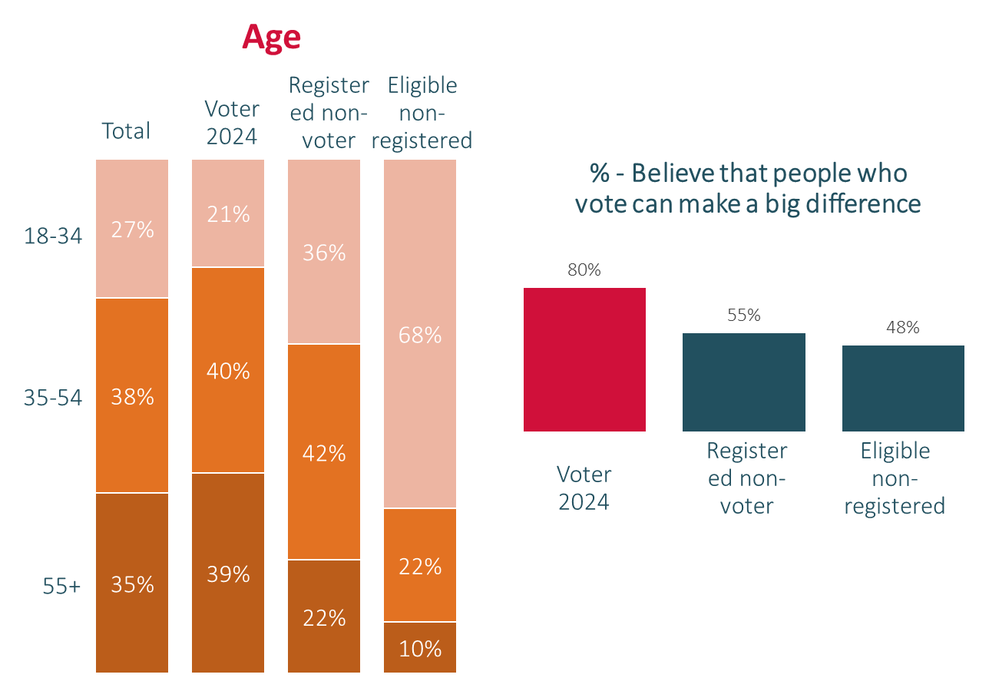

Highlighted the need to encourage greater youth participation in elections and show them why their vote matters
The Commission turned RED C’s insights into immediate action, targeting Freshers Week, Electric picnic and other events with high young footfall.

Slide 8
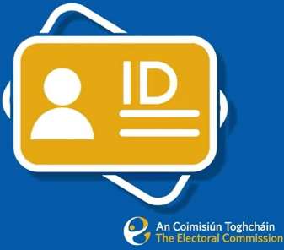
Identified clear knowledge gaps of how to vote among the electorate
I need my polling card in order to vote (True/False)
Don’t know
We measured how many statements each respondent correctly answered.
This later informed PSA campaigns.
E.g. informing polling cards are not required to vote
Correct
Incorrect

Slide 9
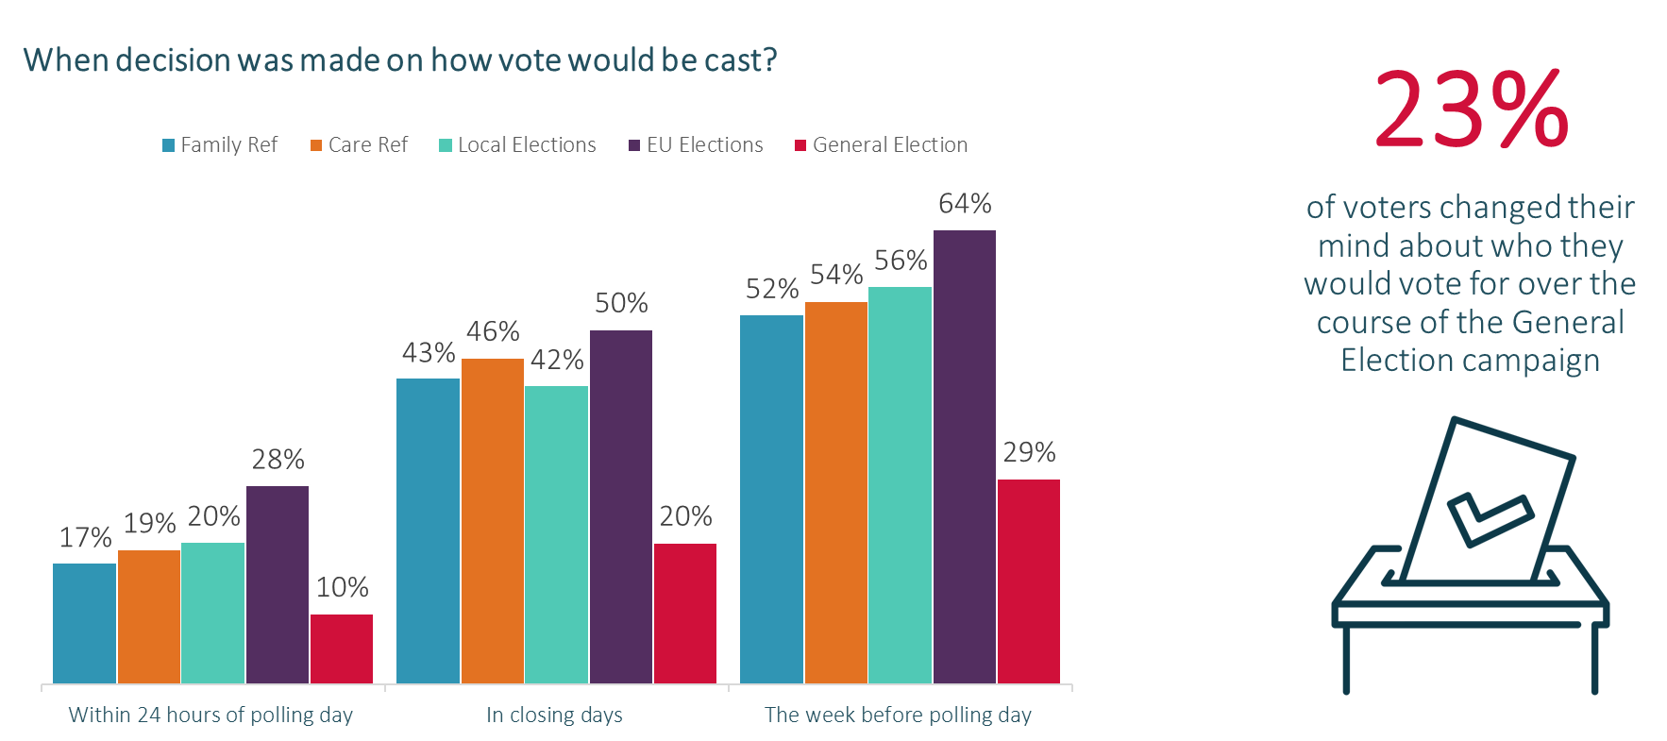
Established that Ireland’s electorate is becoming more volatile
Many voters are only making up their mind about how their will vote in the week prior to the elections.

Slide 10
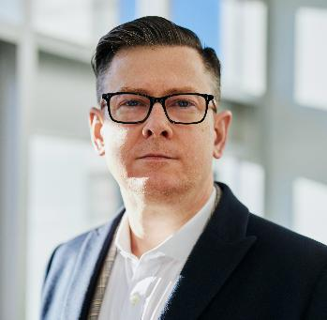
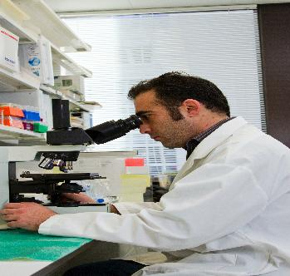

Identified the need for better education of voters on key topics
There is relatively high belief in conspiracy theories in Ireland.
34%
28%
24%
Believe a small secret group of people is responsible for making all major decisions in world politics
Believe groups of scientists manipulate, fabricate, or suppress evidence in order to deceive the public
Experiments involving new drugs or technologies are routinely carried out on the public without their knowledge or consent

Slide 11
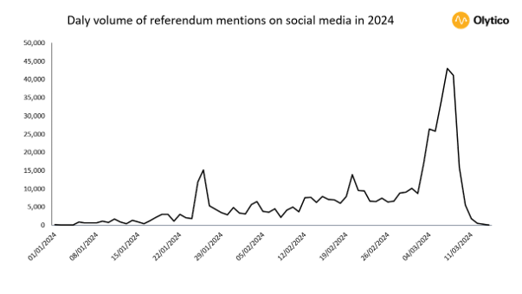
Uncovered the importance of clear wording for referendums
Which had a major impact during the referendum campaigns, particularly in the closing days
Reasons for voting NO
Main
reason %
Any reason %
Durable relationships (e.g. poorly defined/open to interpretation)
Wording is confusing/unclear
Attack on traditional marriage/marriage being devalued
Family Referendum
Main reason %
Any reason %
Just feel it is appropriate to vote this way
Wording is confusing/unclear
The language does not go far enough/gov watered down the wording
#​ | No. of Mentions on X​
#VoteNoNo​ | 200,000​
#VoteNoRef24​ | 95,000​
#VoteNoNoRef24​ | 30,000​
#VoteYesYes​ | 17,000​
#VoteYesNo​ | 16,900​
Care Referendum

Slide 12
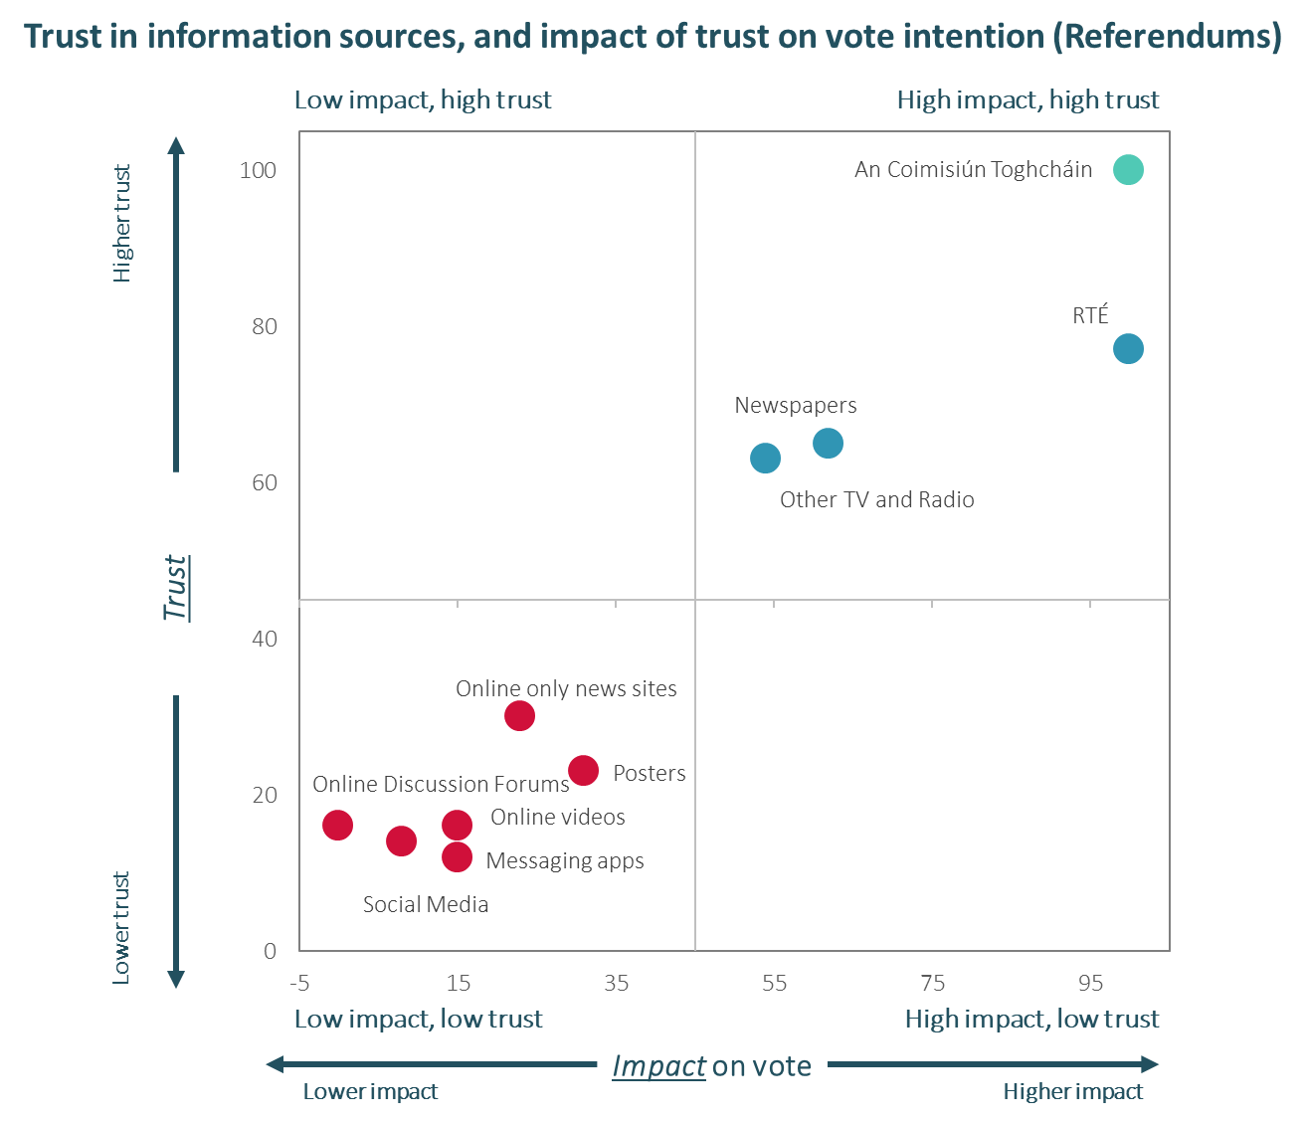

Identified the importance of the Commission as a trusted source of information for voters

Slide 13



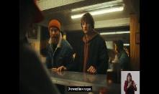
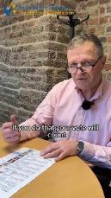
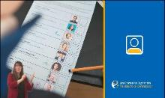


We tested, refined & informed campaigns to boost voter turnout
RED C performed campaign testing to track awareness, trust and overall impact of campaign materials. Both familiarity and trust improved through 2024.
Impact of leaflet on Understanding of Referendum Topics (NET 8-10 understanding)
Voter Campaign materials analysed in 2024
TV
Digital Video
Don’t let people choose for you
Total 41%
Total 35%
How to vote? (Socials)
How to Vote
Radio
Baby Who
What you need to vote
What you need to vote

Slide 14
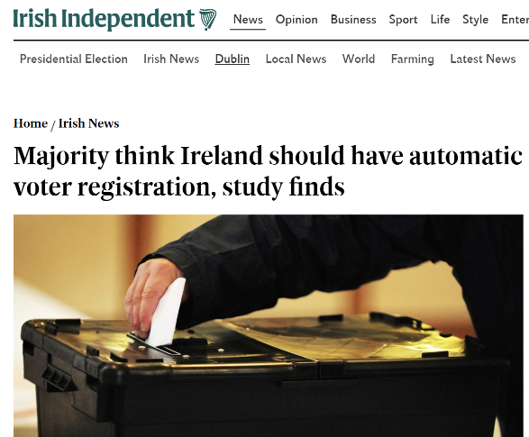
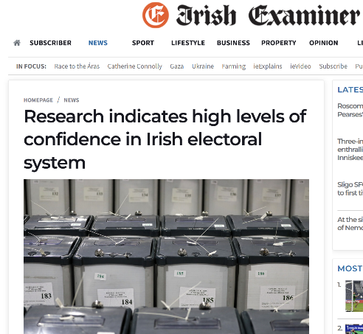
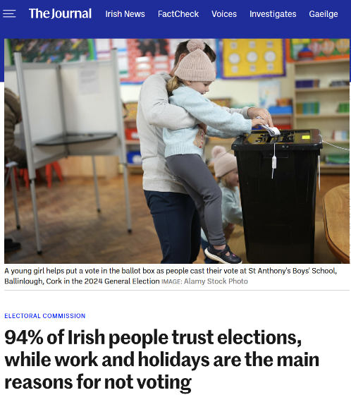
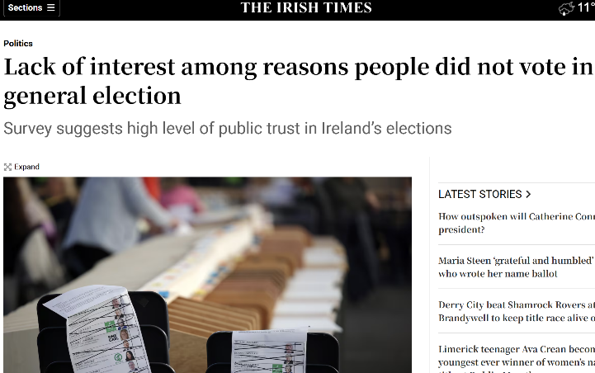
Delivered output that provided real insights into voter attitudes and behaviour, shaping informed debate in the media

Slide 15
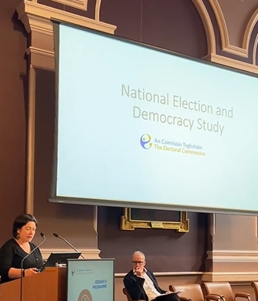






Significant academic impact with insights widely adopted across universities and researchers.
Academic publications
Teaching Tools
Comparative studies
Dissertations & post-grad studies
Foundation for future research
Leaving Cert

Slide 16
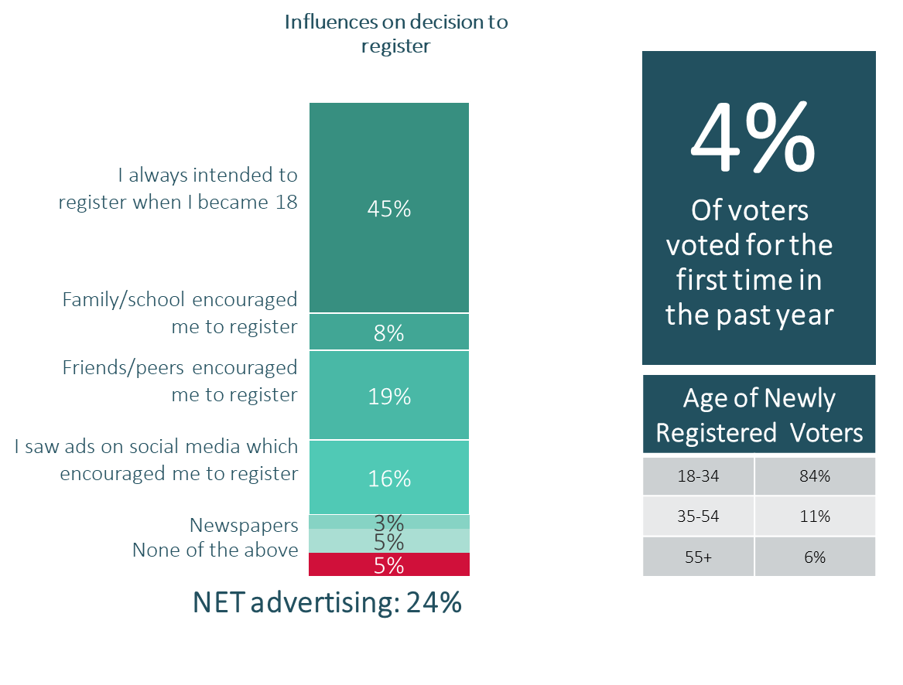
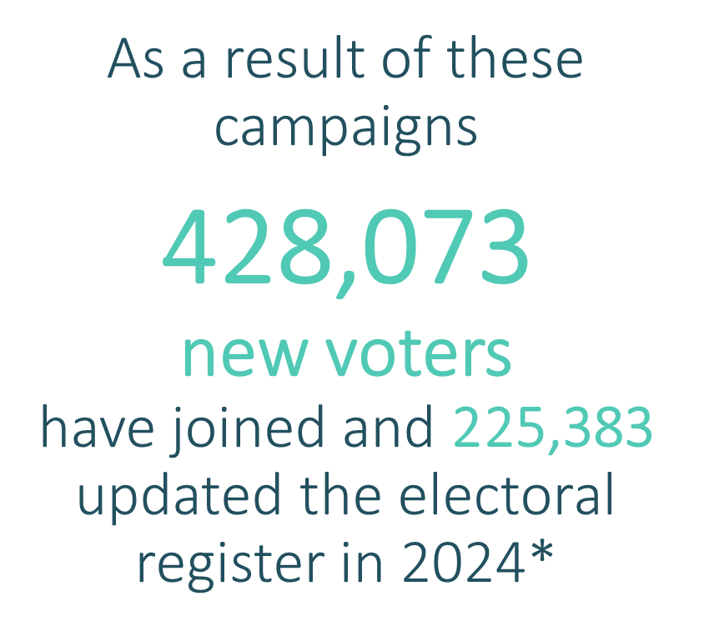
RED C insights ultimately helped drive voter engagement
The insights provided into the research into young people’s disengagement or hesitancy to get involved in the electoral process informed the campaign strategy encouraging voting registrations.
* Electoral Commission Press Release 13th Nov 2024

Slide 17


