Slide 1
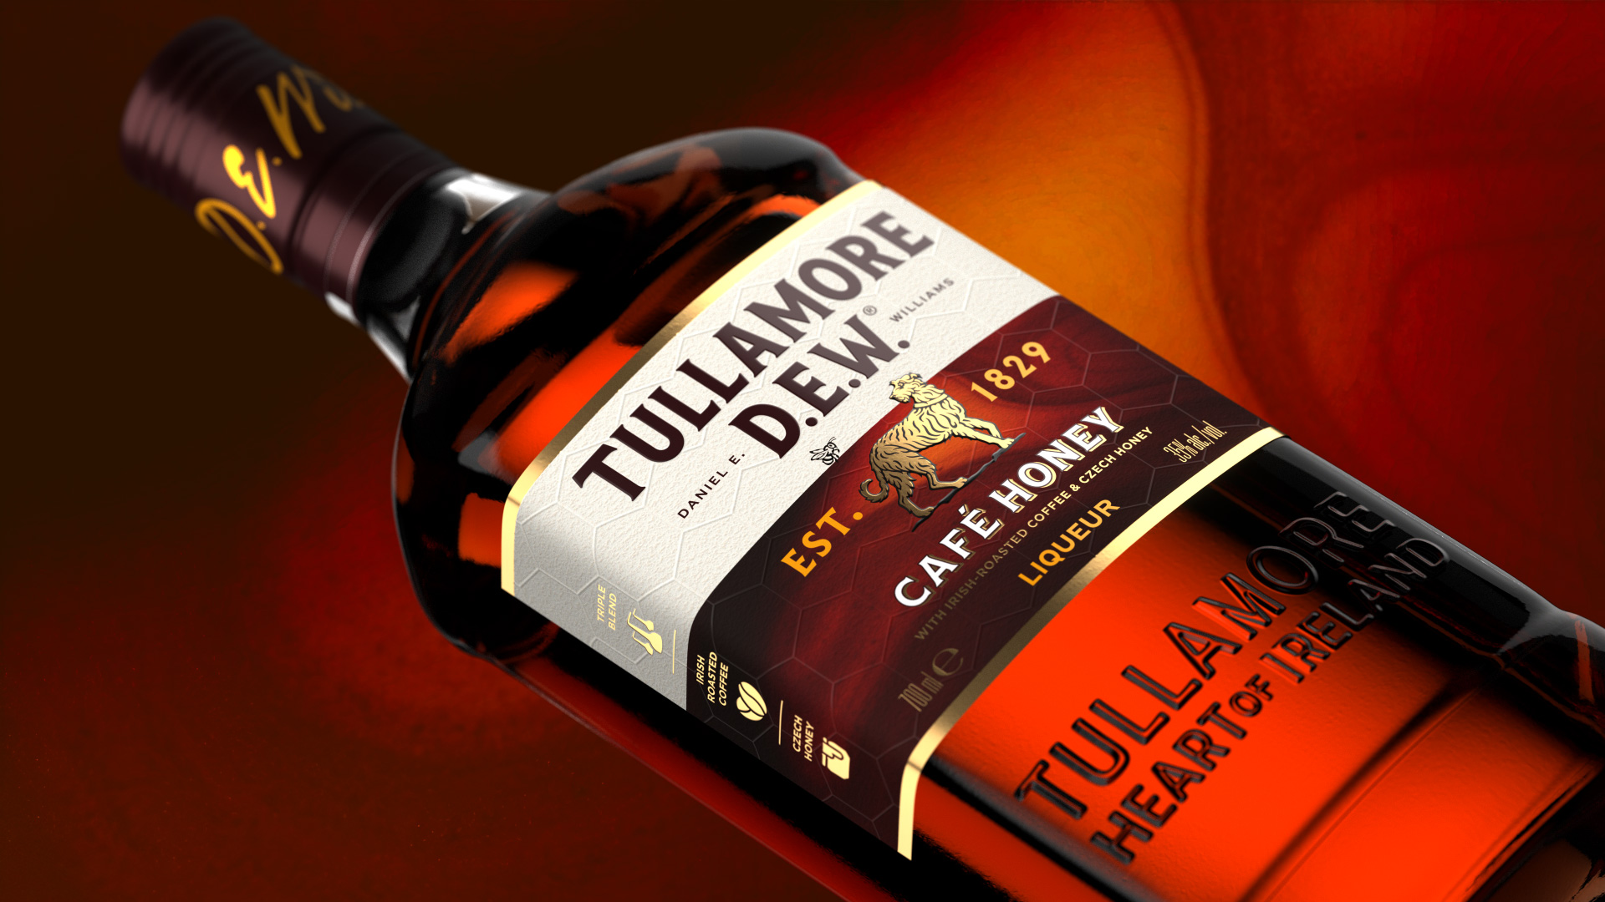

Research Excellence Awards: January 2026
Tullamore D.E.W.
Café Honey
A new blend of Craft, Community and Culture
Notes:
This is the story of how an Irish whiskey brand chose connection over convention — and found a new path to growth.

Slide 2
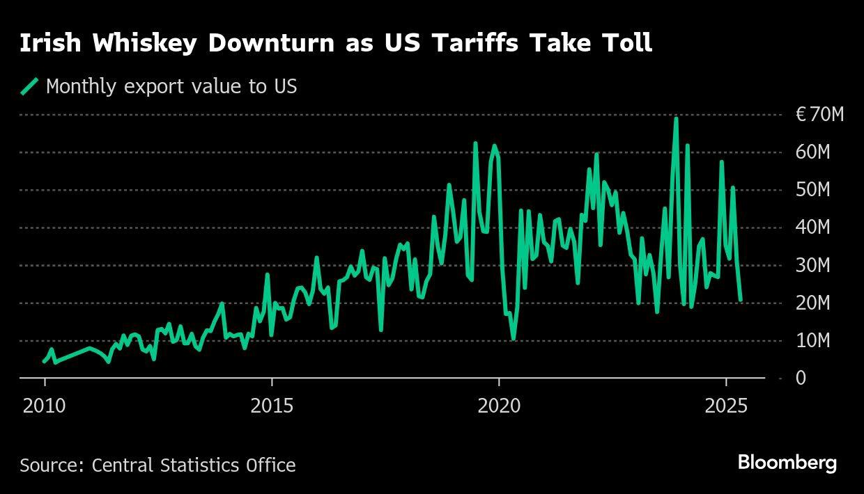
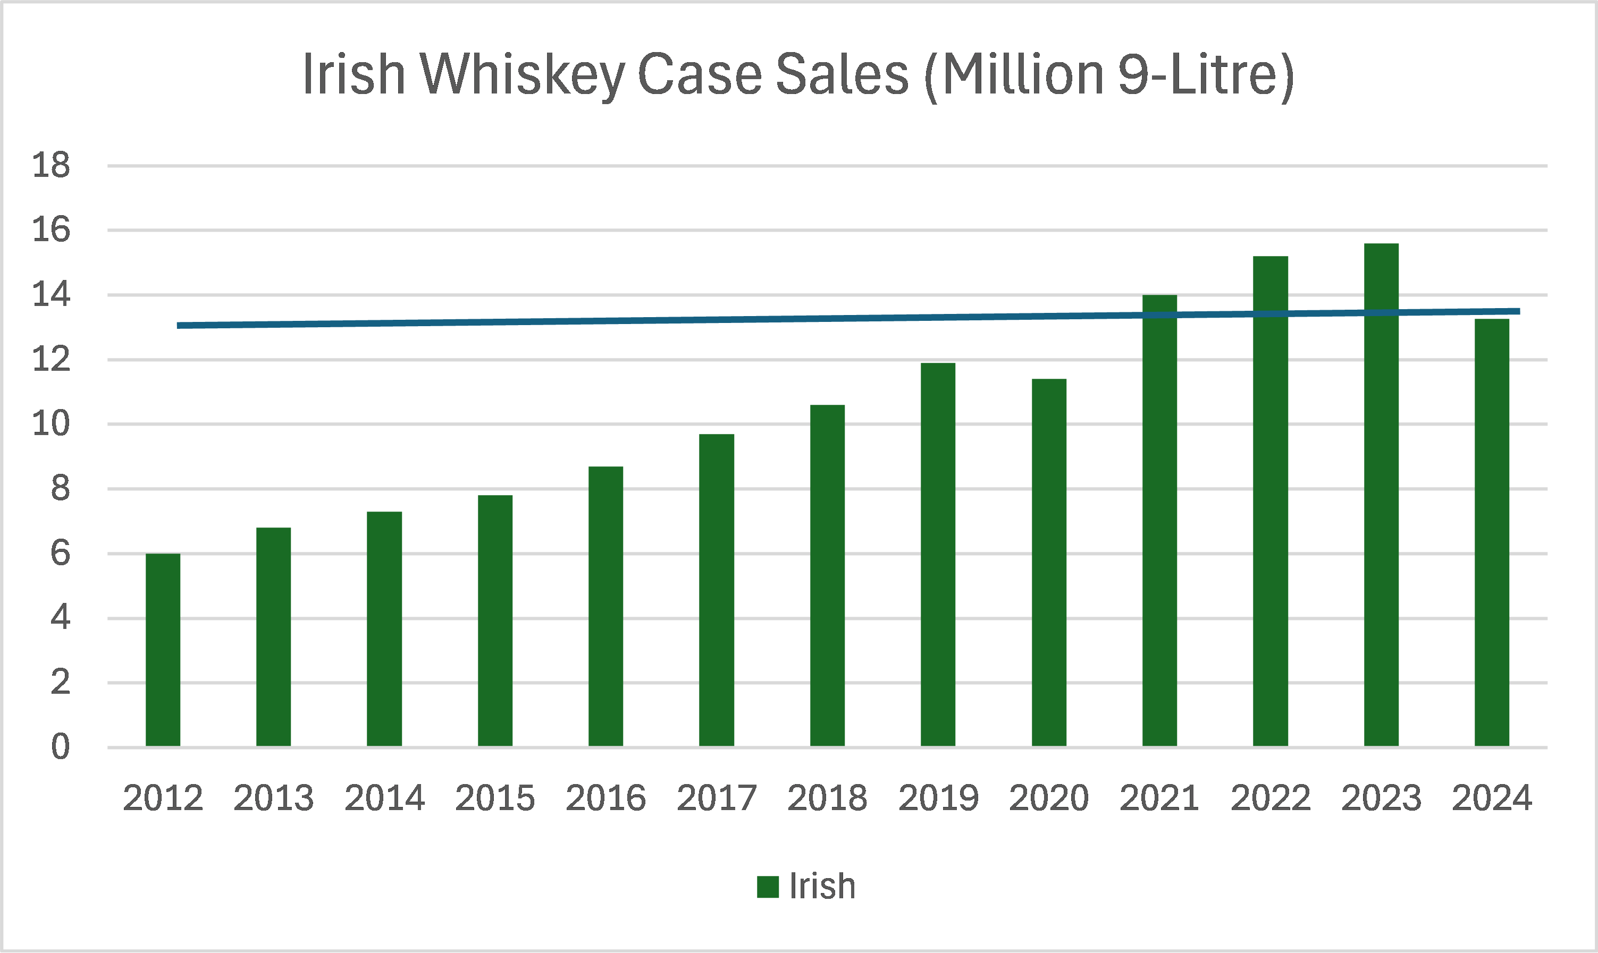

Momentum.
Irish whiskey had been one of the world’s fastest-growing spirits for over a decade, but growth is slowing and becoming more fragmented.
Notes:
Irish whiskey grew fast for a decade.
Then growth slowed.
Fragmentation increased.
And younger drinkers started looking elsewhere.
The category didn’t lose quality. It lost cultural momentum

Slide 3
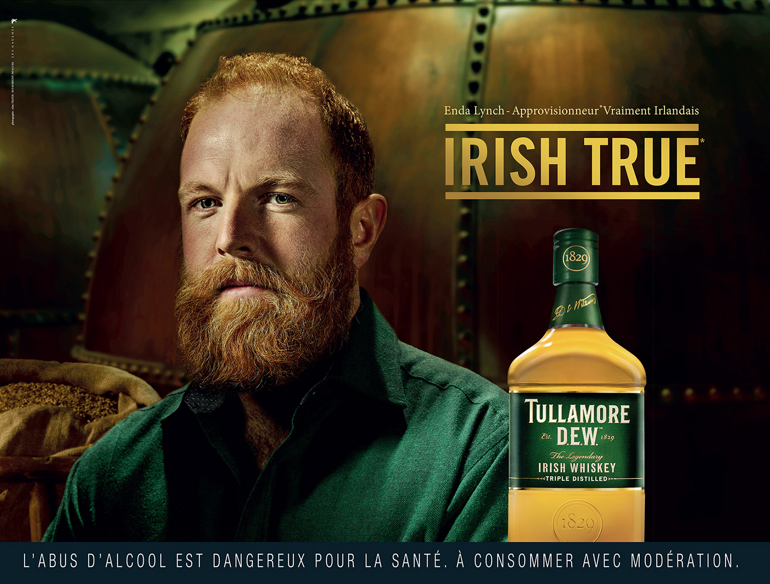
Challenge: how do you premiumise, without losing your soul?
Tullamore D.E.W.’s authenticity and warmth were powerful strengths, but they risked feeling traditional in a world craving flavour, playfulness and social energy.
Notes:
Tullamore D.E.W. had warmth, authenticity, and heritage.
But risked feeling traditional in a world craving flavour, playfulness, and social energy.
This isn’t a whiskey problem. It’s a modern brand problem
More Recruitment | More Premiumisation | More Meaning

Slide 4
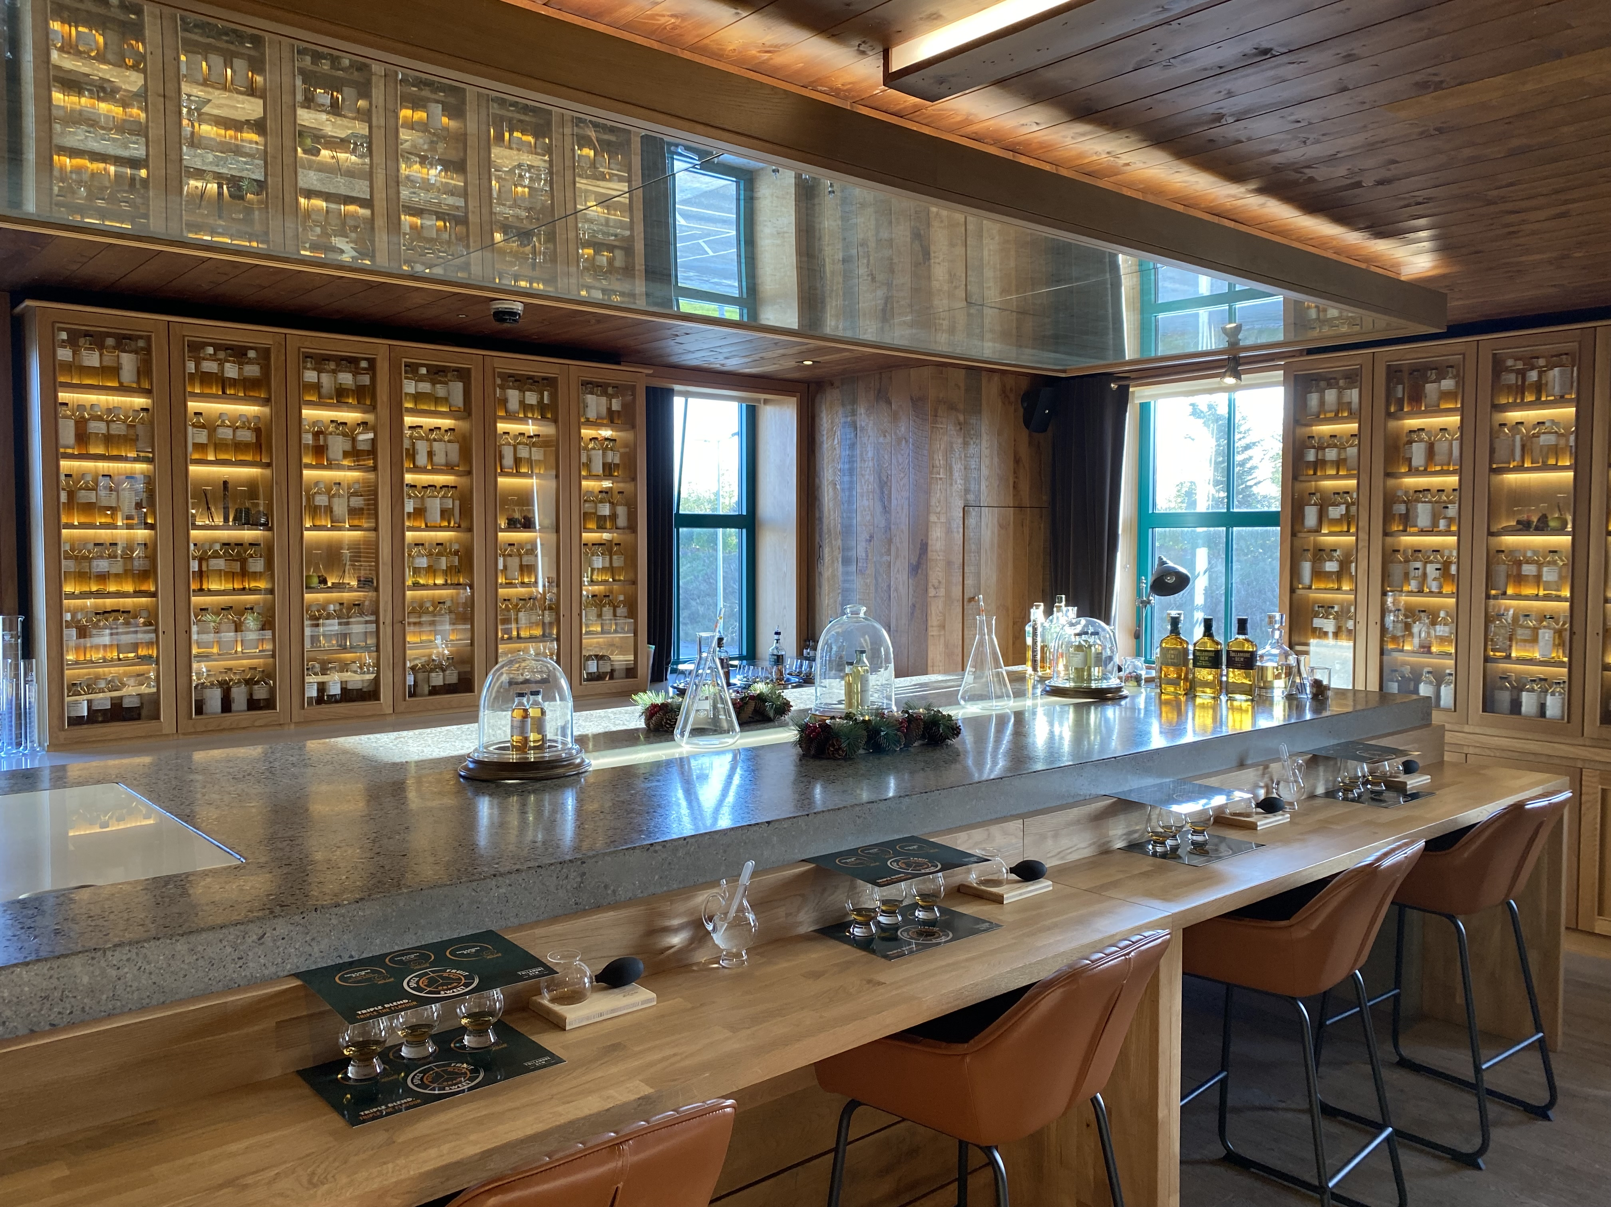
The Ambition: Bring Tullamore D.E.W.s beautiful Irish spirit to the world in ways that feel new, relevant and deeply social.
01
Cultural Foresight Mapping
02
Global consumer and trade ethnography
03
Brand Architecture and Platforms
04
Ideas and Concept Development
Notes:
01
Cultural Foresight Mapping
to understand the rules of modern premium
02
Global consumer and trade ethnography
to explore new spaces and our potential ways in
03
Brand Architecture and Platforms
to define where to play and how to win
04
Ideas and Concept Development
to create a new expression of TD

Slide 5
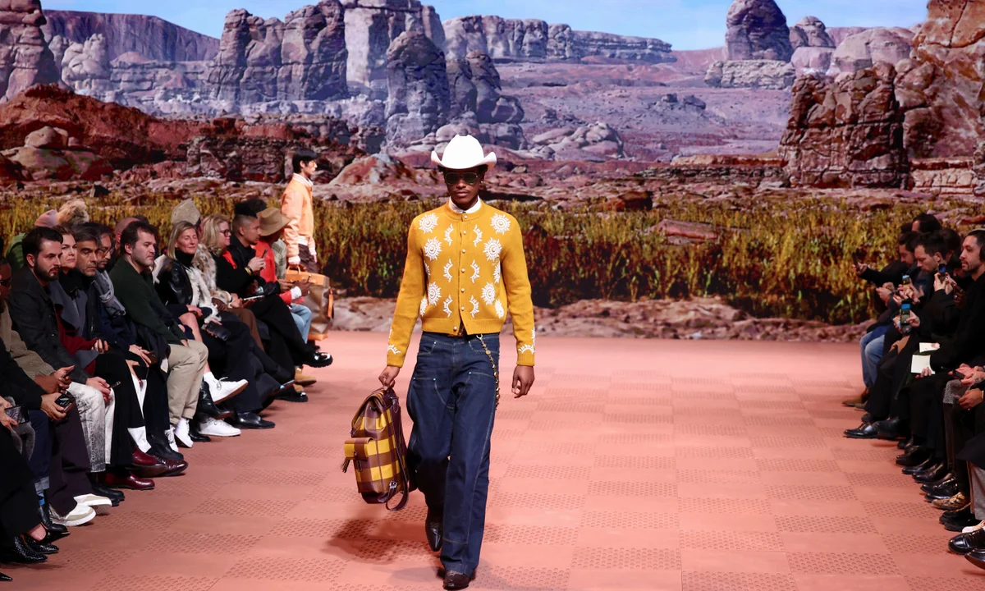
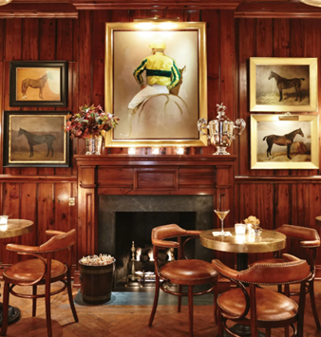
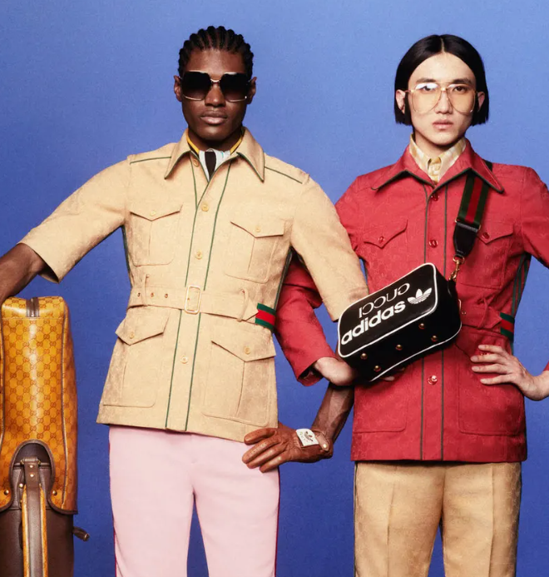
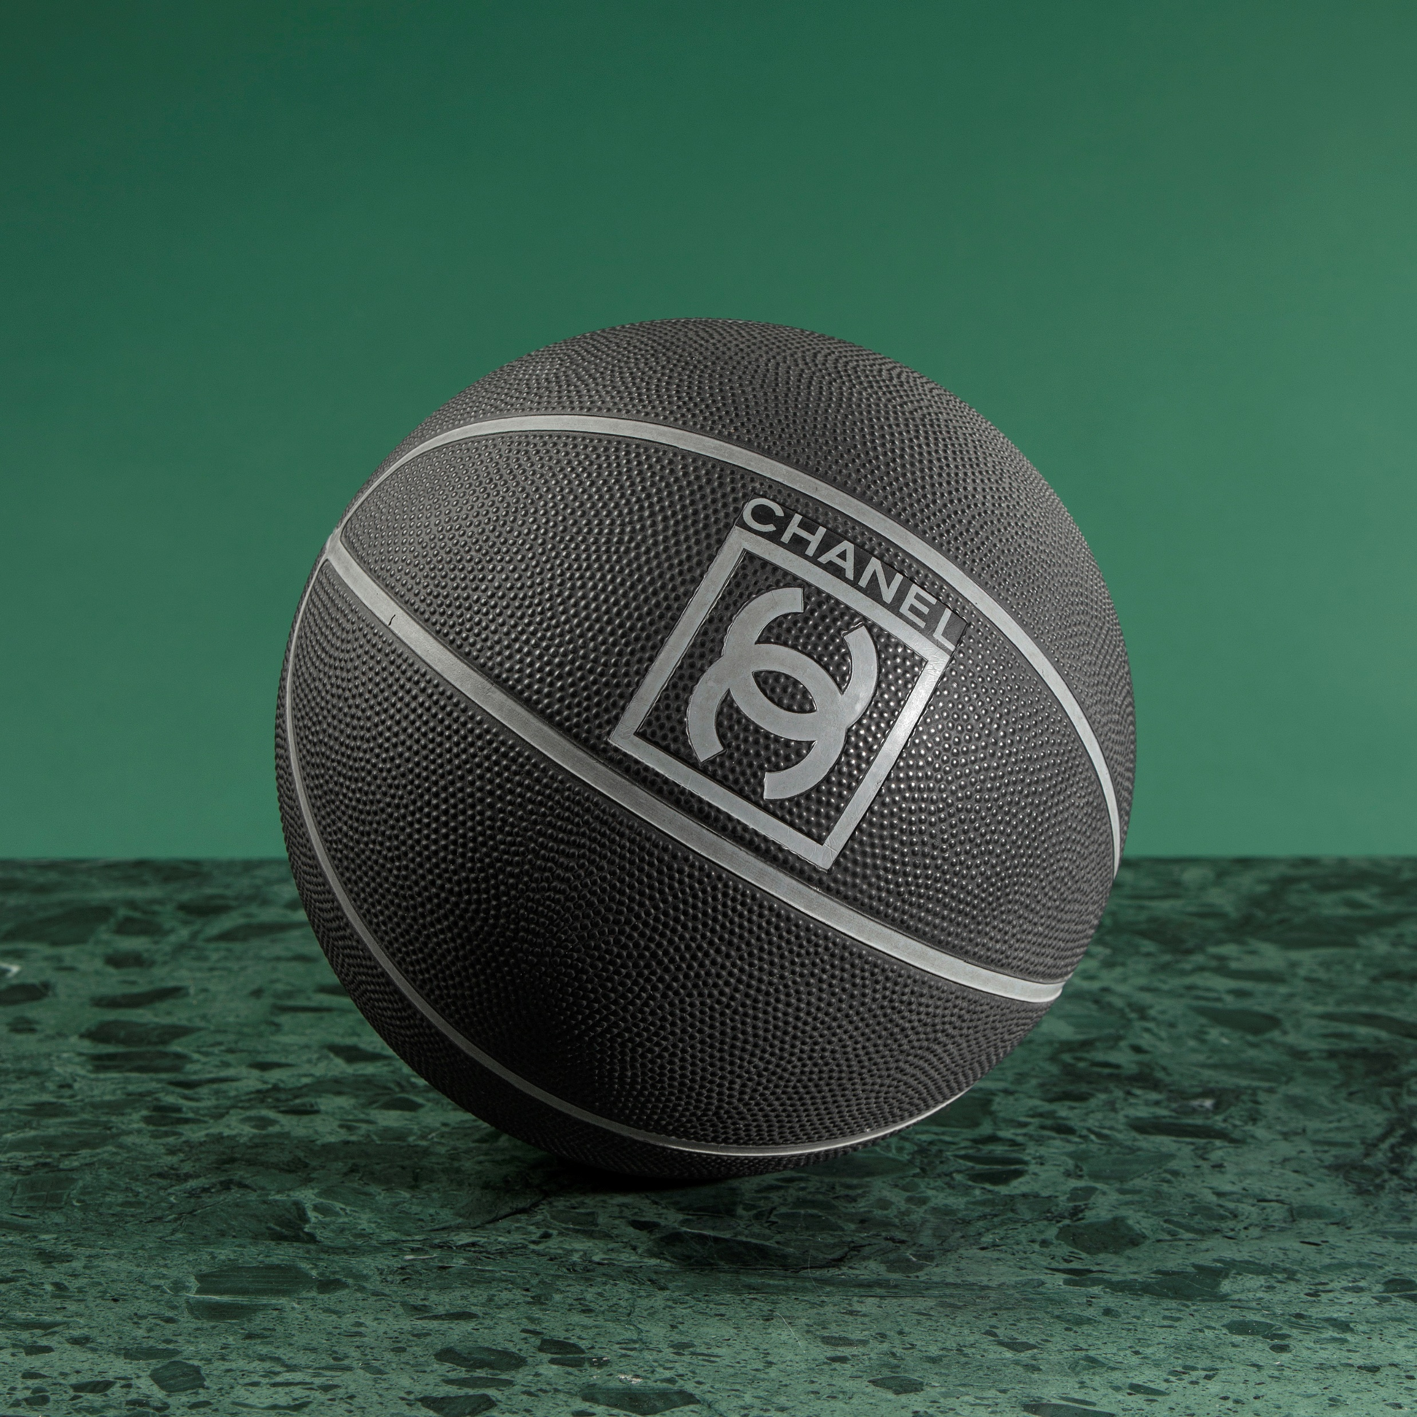
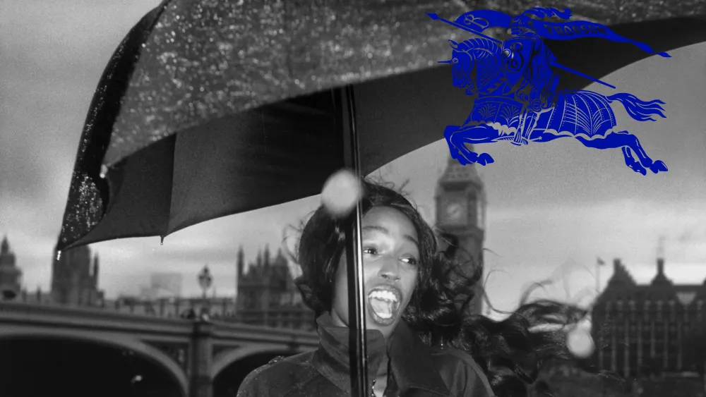
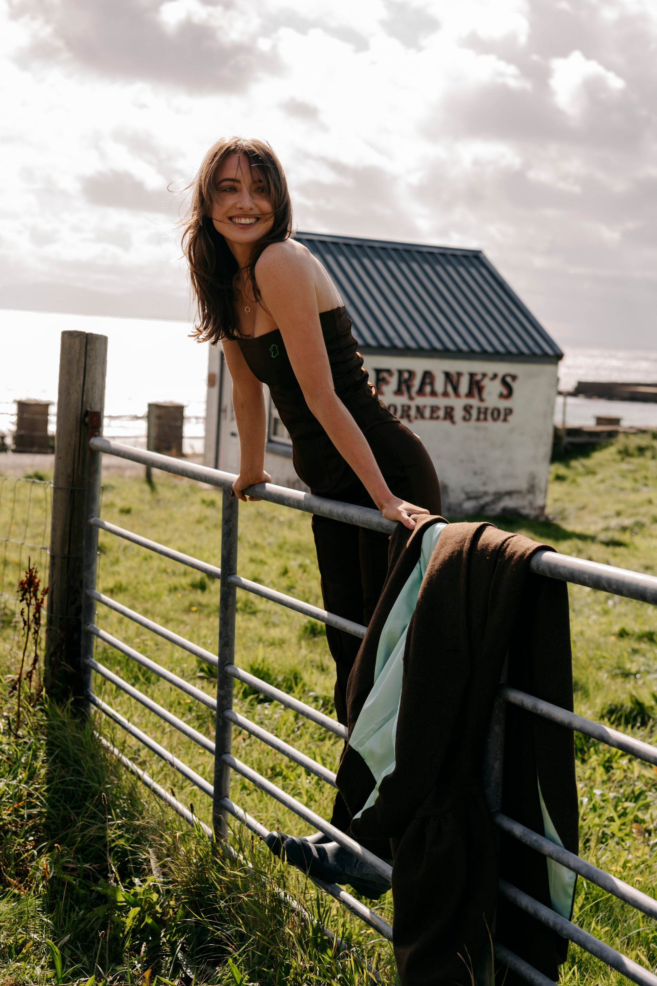
‘Premium’ has changed.
Old World New World
Status Story
Heritage Living Culture
Aspiration Belonging
Pristine Human Connection
Notes:
Premium today isn’t about being admired. It’s about being invited

Slide 6
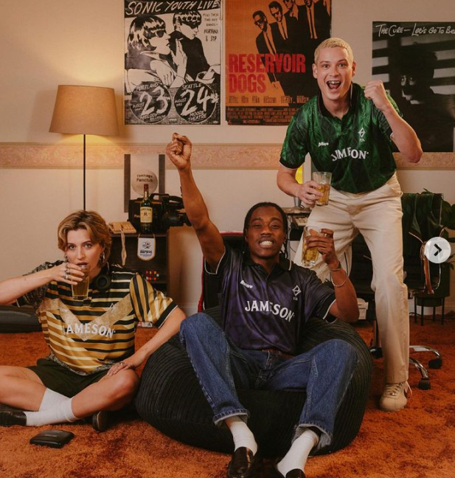
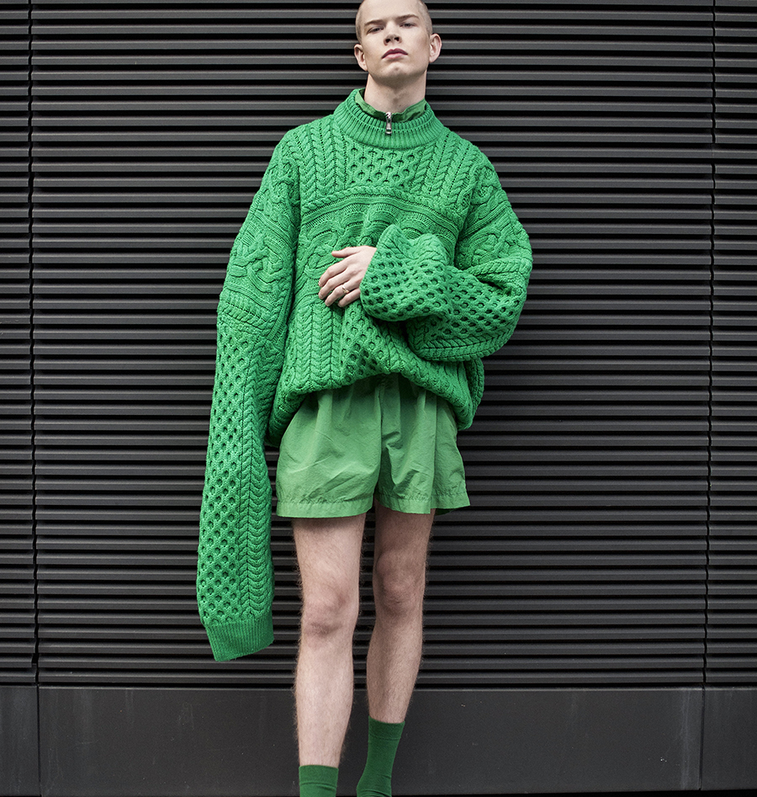
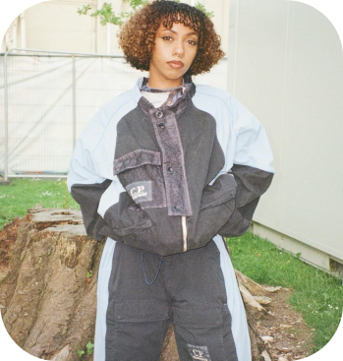
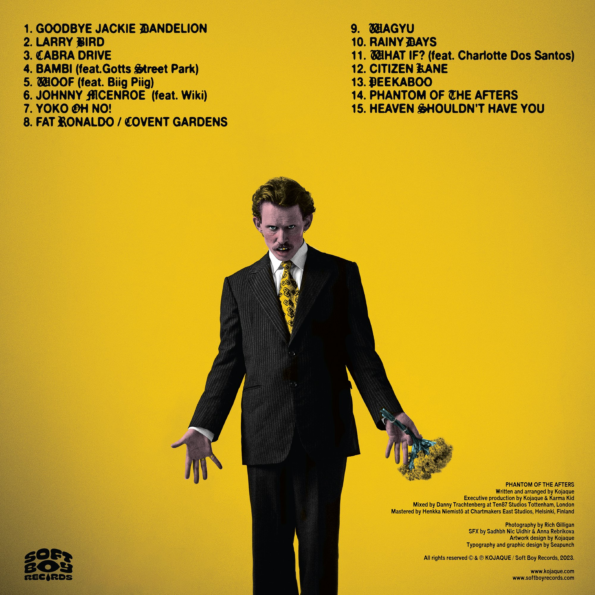
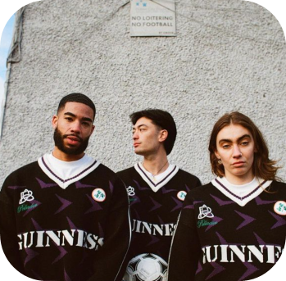
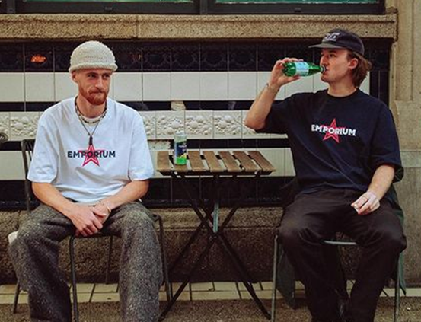
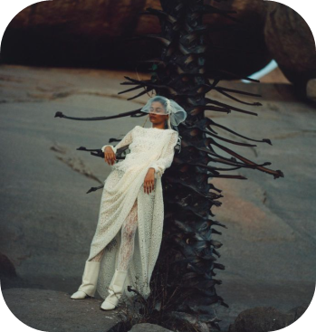
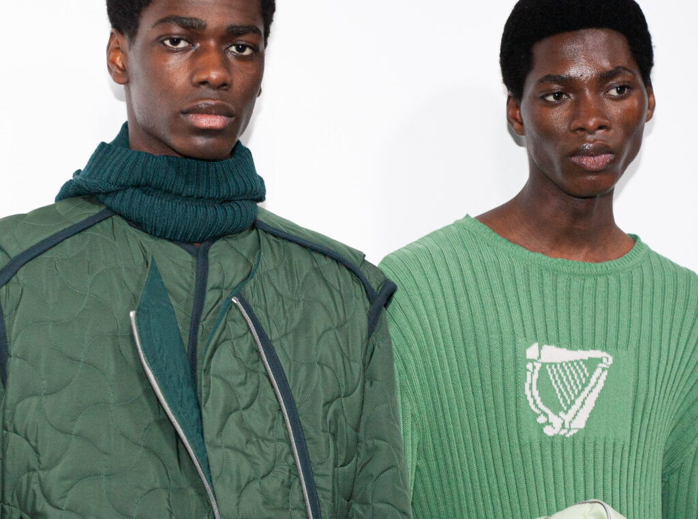
Redefining Premium Irishness.
For us, premium now means cultural confidence and community, not status or polish.
JOYFUL
PROUD
RAW
UNAPOLOGETIC.
COMMUNITY-POWERED
FEARLESS
COLLABORATIVE
FOLKLORIC

Slide 7
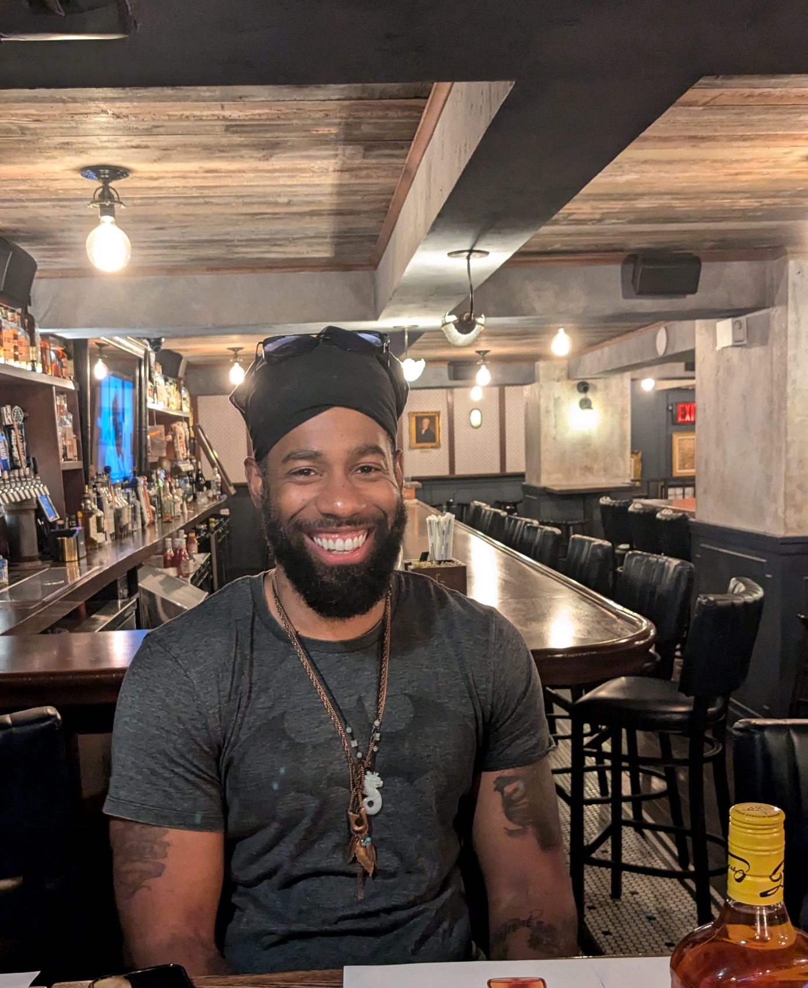
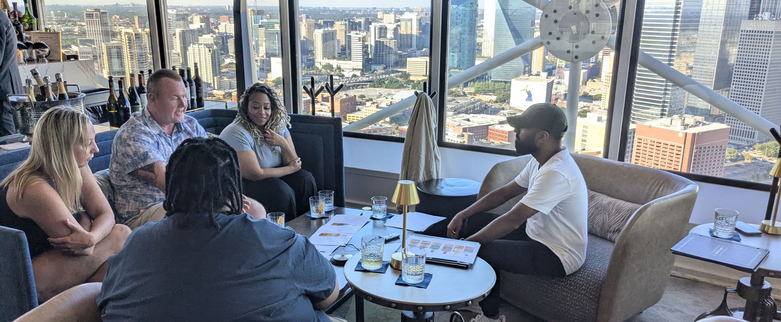
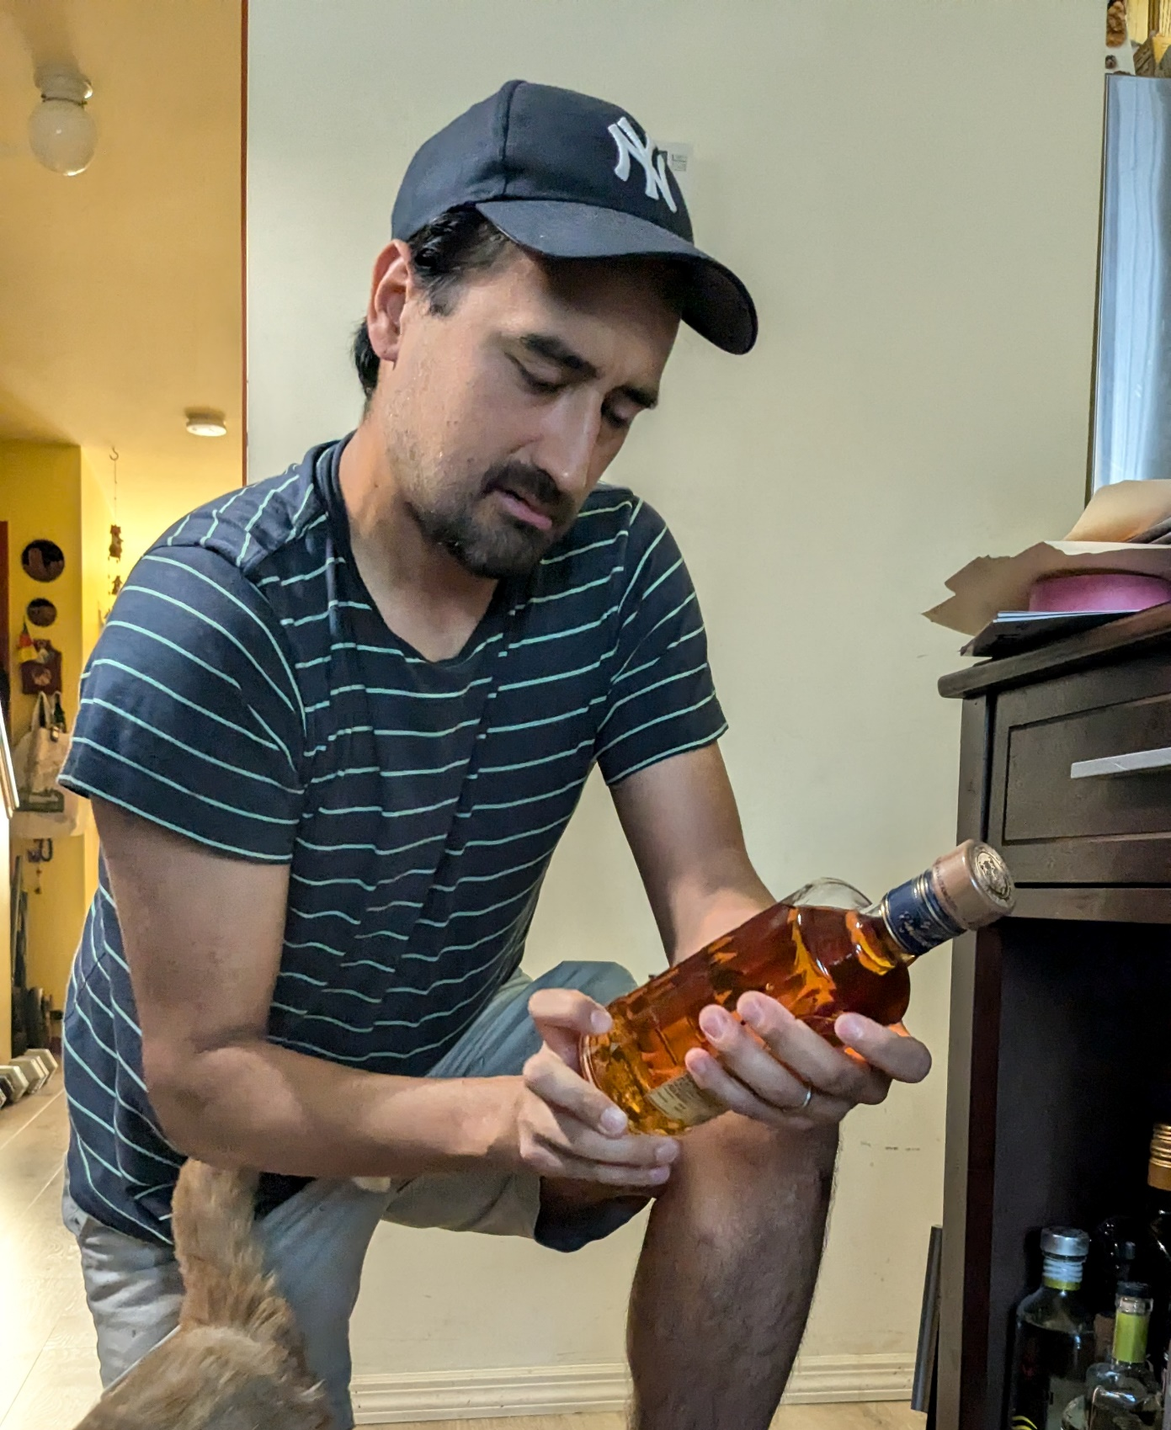
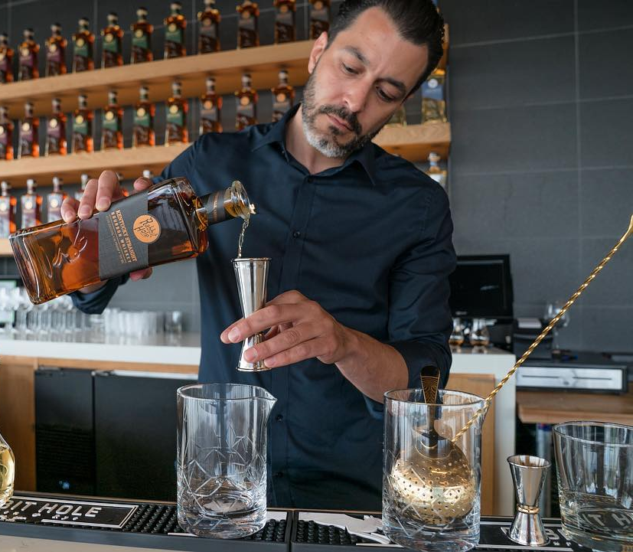
7
“A blend is one of most powerful human ideas …once things are blended, they can never be undone. They’re together forever. So whiskey isn’t just great craft, it’s connection”

Slide 8
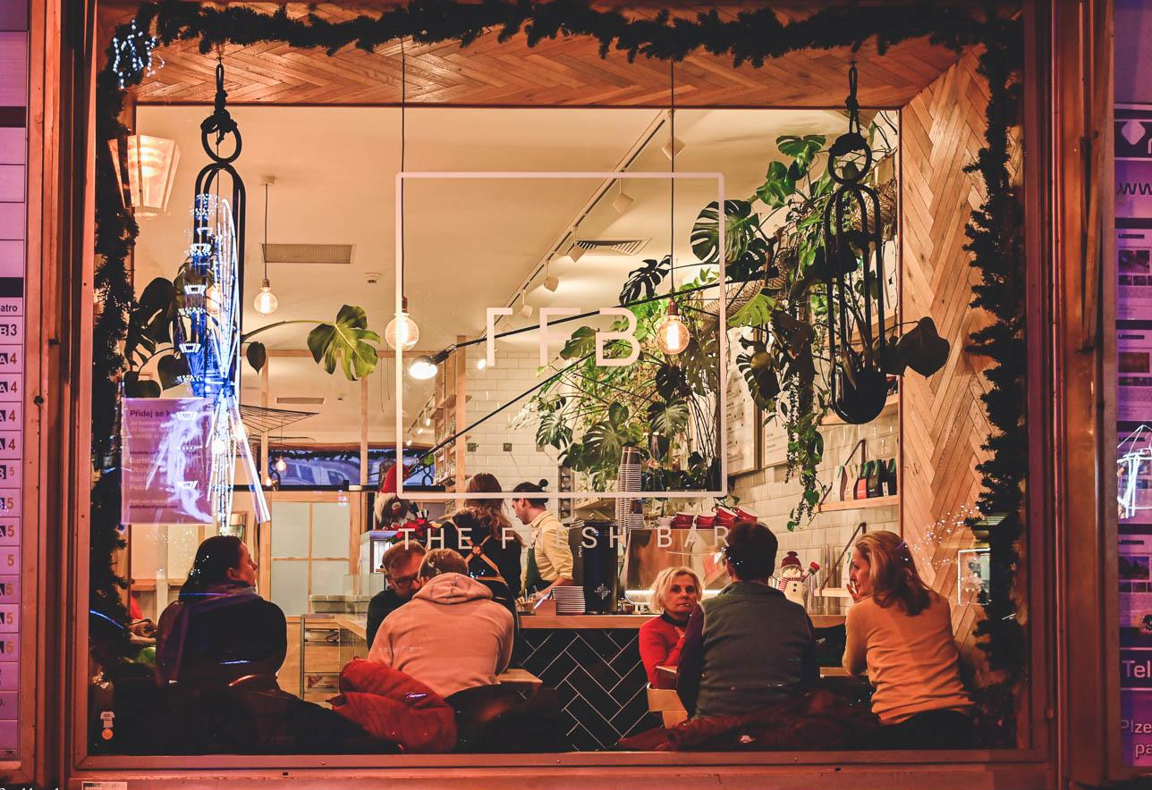
So where does Irish culture and new types of connection go next?
We explored multiple spaces and places where the brand could play.
Café culture felt right.
Warm. Social. Modern.
A new kind of pub for a new generation.
Notes:
We explored multiple cultural spaces where Irish conviviality could live next —
music, food, festivals, modern pubs, collaborations, and rituals of togetherness.
One space stood out.
Not borrowed. Not forced. Already social.
Café culture.

Slide 9
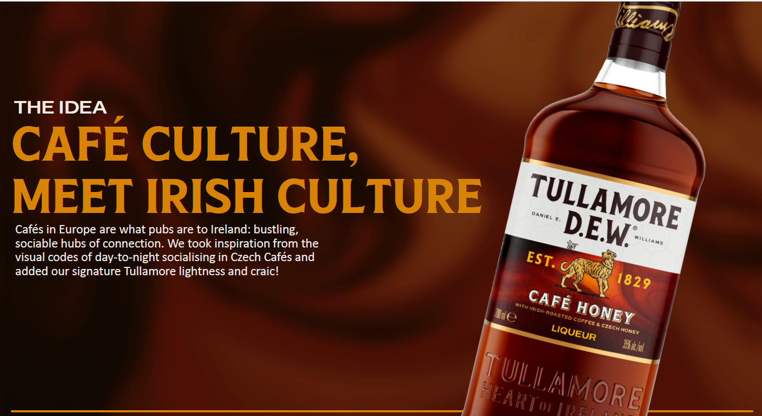
The Breakthrough: Irish Whiskey as a blend of craft, community and culture.

Slide 10
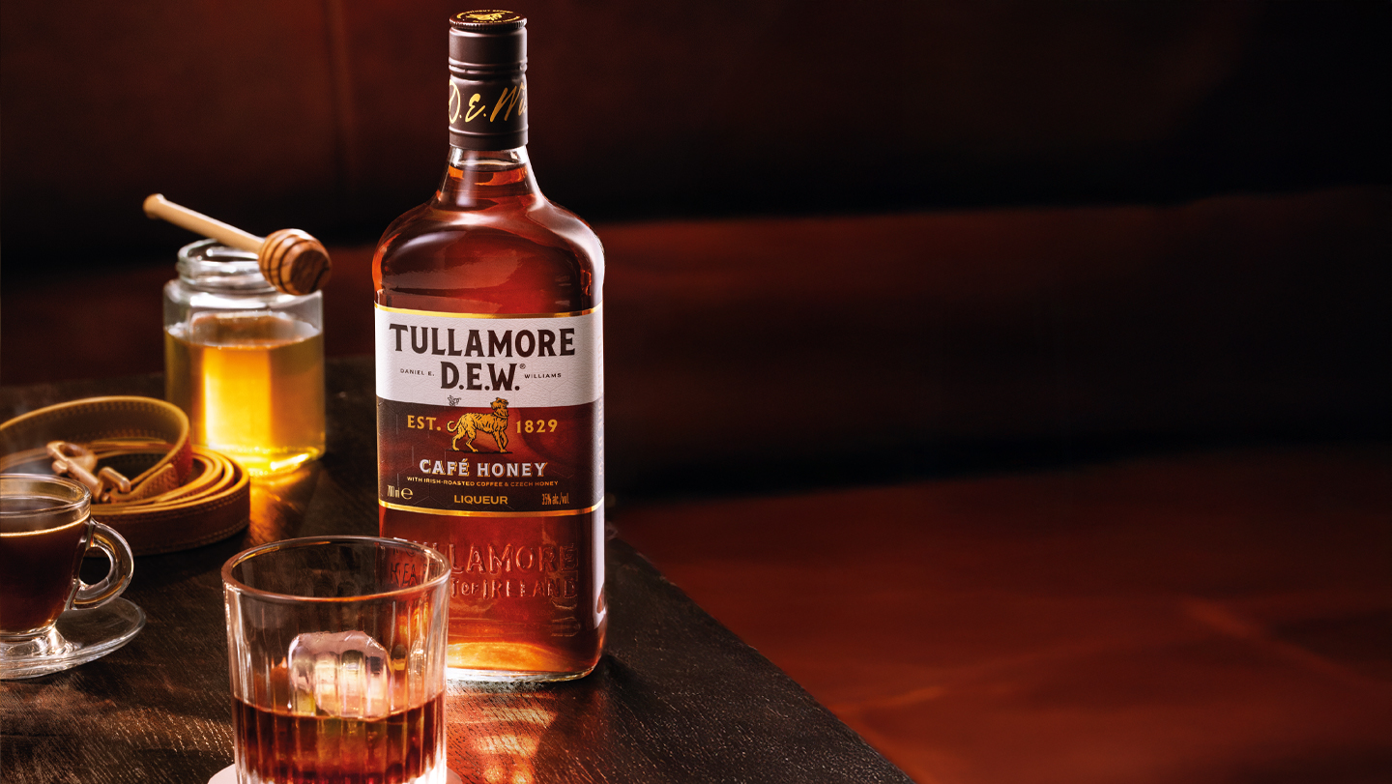
The proof is in the pour.
Volume ahead of target
Top-tier European listings
Gold: Global Liqueur Masters 2025
Category-leading trial and repeat

Slide 11
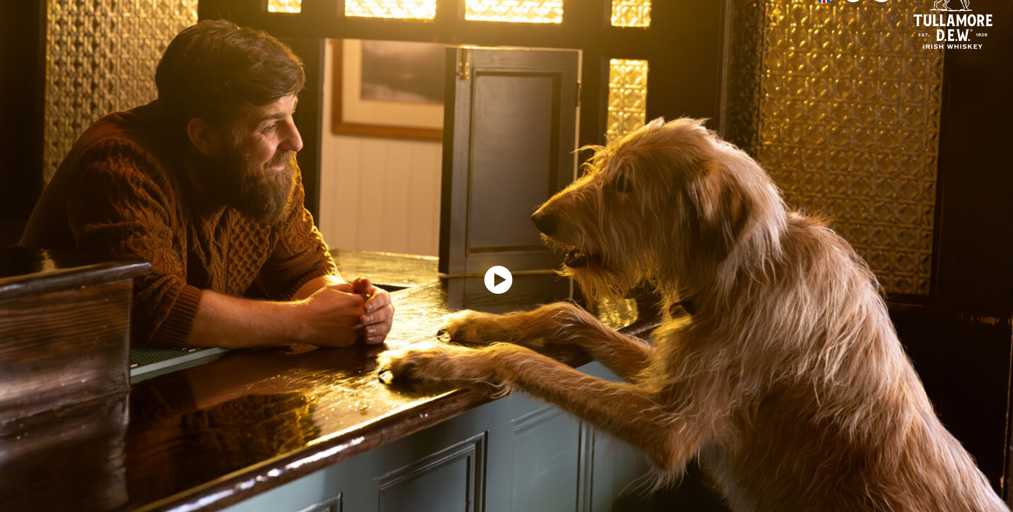
Because everything good starts and ends with connection.
“Good whiskey feels like it was made by someone who loves people, not just distilling”.
Notes:
More Recruitment | More Premiumisation | More Meaning

Slide 12
Research Excellence Awards: January 2026
Tullamore D.E.W.
Café Honey
A new blend of Craft, Community and Culture

