Slide 1



Beyond Skin Deep
Building the Future of WaterWipes Through Intelligence-Led Portfolio Innovation
Presented by Robert Flavin, ReAction & Brian Greene, Opinions
29th January 2026

Slide 2
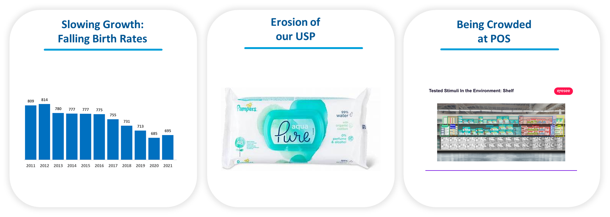

Context of the Research
Baby Wipes Category Stagnating;
WaterWipes needed to innovate to ‘Beyond Baby’.
Falling
Birth Rates
Erosion of WaterWipes USP
Being Crowded
at POS

Slide 3
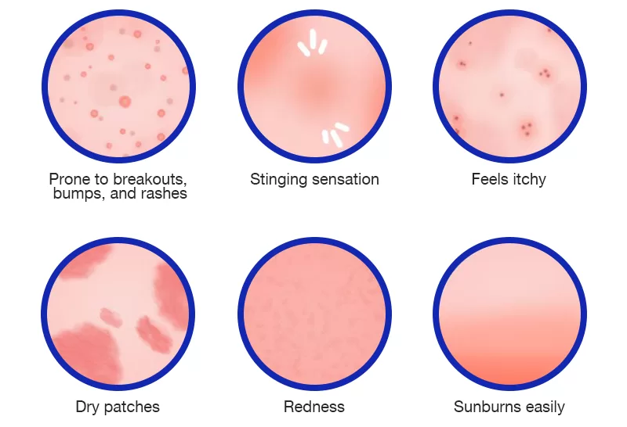

WaterWipes recognised a potential opportunity to evolve Beyond Baby. Brand DNA of Purity and their unique water technology, provided a way into Sensitive Skin across life stages.
Beyond Baby
Sensitive skin is
the new normal.
71%
of consumers across countries self-reported having sensitive skin, up 55% in 20 years.
Older adults 50+ / carers
Adults 18+ personal use
Parents of older kids
UPDATE
New Parents
Wipe Users
The Trend
Symptoms of Sensitive Skin affects all life stages

Slide 4


‘To protect skin at every age and stage in life and protect the category by focusing on the expandable nature of wipes consumption’.
Undeniable NPD opportunity.
WaterWipes had an amazing USP but needed to drive additional skin benefit technology.
The challenge was to align on which unmet consumer needs and prioritise.

Slide 5

Learning Plan
Provide quantified directional growth mapping for WaterWipes.
Grow WaterWipes penetration at relevant life stages and usage occasions, that align with WaterWipes’ strengths AND drive profitability.
Identify Where Growth Lives

Slide 6

Road Map For Growth
Advanced Analytics on Robust Research
Shopper & Revenue Triangulation
Opportunity Identification
Interactive Interrogation Tool

Slide 7
Needstate Modelling
Almost 5,000 skincare wet wipes buyers across
UK, USA and France,
told us what really mattered to them when it came to skincare wet wipes.
6 Distinct Needstates

Slide 8

From People to Pounds*
This work needed to go deeper than just
identify unmet consumer needs…
Needstates were mapped to 100s of leading SKUs across the 3 markets.
This revealed revenue opportunities
to prioritise growth areas.
*And Euros and Dollars…..

Slide 9
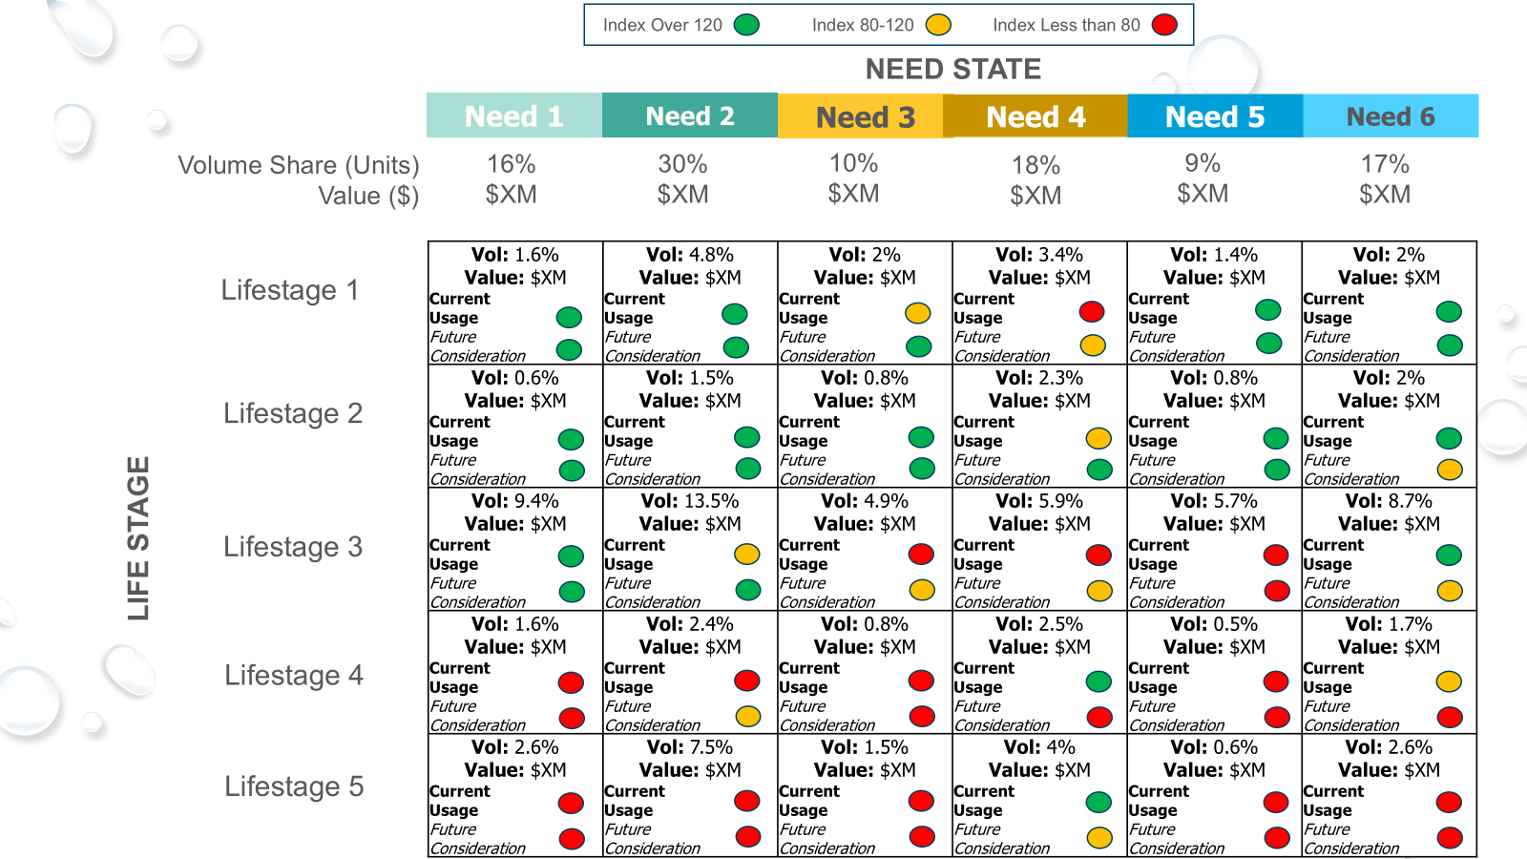
Growth Mapping
Overlaying Lifestage allowed for more granular view of “big bets” to go after.
*Illustrative Data Shown

Slide 10
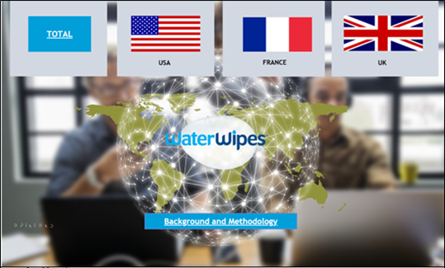
Interactive Visualisation Tool
Democratisation of the intelligence system made impact far-reaching
Ability to create bespoke customised insight-led report within minutes
"A Superpower" for global category teams, helping secure expanded listings, premium shelf space, and new distribution opportunities around the world.

Slide 11

Findings Which Drove Innovation Strategy …
1
2
Cleaning and skincare is intertwined and indistinguishable
Sensitive skin is the norm, not the niche
3
4
Emotional reassurance of proactive support drives loyalty
Purity is necessary but not sufficient

Slide 12
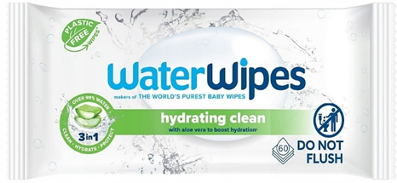

The First Steps In Building A ‘Beyond Baby’ Portfolio.
Incorporating new product technology and superior skin benefits.
First step in establishing confidence in WW becoming a truly for all skin business.
Identified the unmeet consumer needs.
Built on the back of intelligence which:
Quantified the growth opportunity.
Delivered Innovation Beyond Baby.
Notes:
Launch of

Slide 13
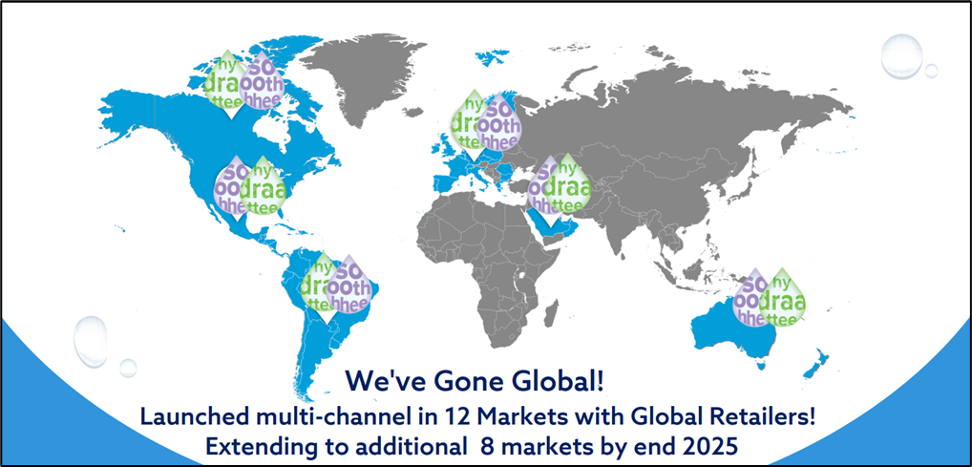

Notes:
Highly successful first 12 months - largely through recruitment, with 3 in 4 buyers being new to the brand
Globally, WaterWipes performing 3 times the category average in terms of growth and is the fastest-growing wipes brand in the UK (bucking the declining trend seen more broadly)
It has reframed how WaterWipes thinks of itself internally and helped redefine the overall category, resulting in expanded listings and premium placement in-store

Slide 14


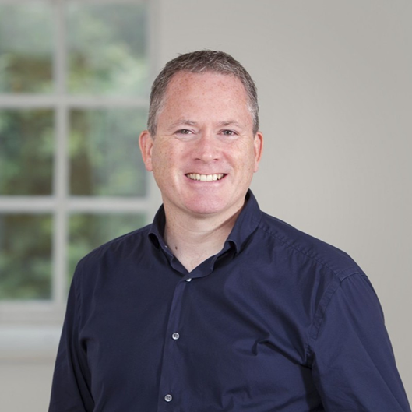
What WaterWipes had to say …
“The success of Hydrating Clean & Soothing Clean represented a key step-change in how we think about our brand and our future.
The research partnership with Opinions and ReAction gave us huge clarity and confidence to evolve into a true ‘for all skin’ portfolio business.
This work has been one of the key foundations for a new internal narrative, a new pipeline of innovation, and a plan that will fuel step change growth by 2029.
A hugely impactful global insight project that has been a critical foundation to our portfolio growth strategy”
Peter Murphy, Global Brand Development Director, WaterWipes
Amanda Smith, General Manager Marketing, WaterWipes

Slide 15
Thank you!

