Slide 1
Beyond the basket
The Irish consumer in 2026;
  A continuing tale of catastrophes and cash-flow
  Shopping ,stopping, or shifting preferences?
Austin Hughes
MSI
26th February 2026

Slide 2
It’s the end of the world as we know it ( and I don’t feel fine)
Shocks now a feature rather than a bug of the global economic system
Irish consumers still in the shadow of the GFC crash
Irish consumers more addicted to media misery than others?
‘Perma-gloom’ or poor mouth?
Irish consumers in wait and worry mode- the ‘precautionary motive means consumers save on rather than for a rainy day….but reasons/opportunities to ‘escape or luxurise’ more valued

Slide 3
Conflicting narratives I; How was the apocalypse for you?
‘Expert warns Ireland is facing 'worst day in Irish economic history'
Near-term growth outlook remains positive but 2026 likely to see some slowdown and more strains
Individual outcomes vary widely and feel notably less positive in a noisier world
A less certain ‘macro’ future is more certain! Problematic predictability
It’s good , it doesn’t feel great

Slide 4
Conflicting narratives II; Whose boom is it anyway?
Aggregate economic and financial conditions are solid and supported by increasing numbers living and working here….
….but are far from spectacular at the level of the individual consumer

Slide 5

Contentious narratives; A k-shaped economy?
Distribution of income and wealth varies widely
€ Billion | Deciles 1-5 | Decile 6 | Decile 7 | Decile 8 | Decile 9 | Decile 10
2025-Q2 | 120.7 | 85.2 | 112.0 | 151.3 | 224.3 | 674.9
2020-Q2 | 67.2 | 49.7 | 67.6 | 92.4 | 139.2 | 409.5
2015-Q2 | 29.1 | 31.8 | 43.7 | 63.3 | 99.9 | 321.8
%chg | 315.0 | 168.1 | 156.6 | 139.0 | 124.6 | 109.7
€bn chg | 91.6 | 53.4 | 68.4 | 88.0 | 124.4 | 353.1
Gains in percentage terms skewed towards less wealthy but absolute gains very much tilted the other way
Household spending power varies markedly

Slide 6
A clear narrative;
  spending power struggles mean sentiment varies markedly
Consumer Sentiment Index Survey Results – Making Ends Meet With Difficulty
 | Jan’26 | Jan'25 | Jan'24 | Jan'20
Consumer Sentiment Index | 52.3 | 60.6 | 61.5 | 74.2
Consumer Sentiment Index Survey Results – Making Ends Meet With Ease
 | Jan’26 | Jan'25 | Jan'24 | Jan'20
Consumer Sentiment Index | 84.0 | 93.5 | 94.3 | 100.8

Slide 7
Unlike the tiger era, price pressures have been largely global in nature but…..
  Anatomy of
  a price shock
Irish inflation overall averaged just 0.1% between 2009 and 2020.
and averaged 4.2% between 2021 and 2025.
Irish energy price inflation averaged +1.2% between 2009 and 2020
averaged +10.4% between 2021 and 2025
Irish food price inflation averaged
-1.5% between 2009 and 2020
averaged +4.6% between 2021 and 2025
Inflation ‘stealing’ income and wealth likely to become more of an issue

Slide 8
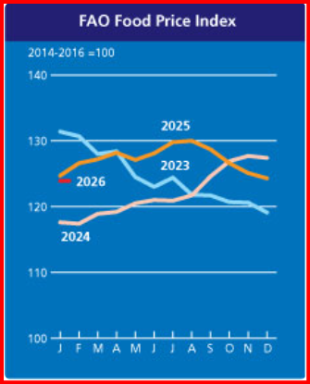
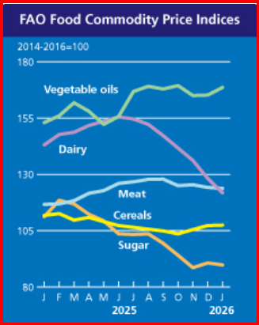
Past the peak in food price inflation but some way off a broadly based drop in prices
Inflation indicators suggest food industry has absorbed much of recent cost pressures
Climate change and policy shifts point to structurally higher food prices-unlikely to be a straight line change

Slide 9
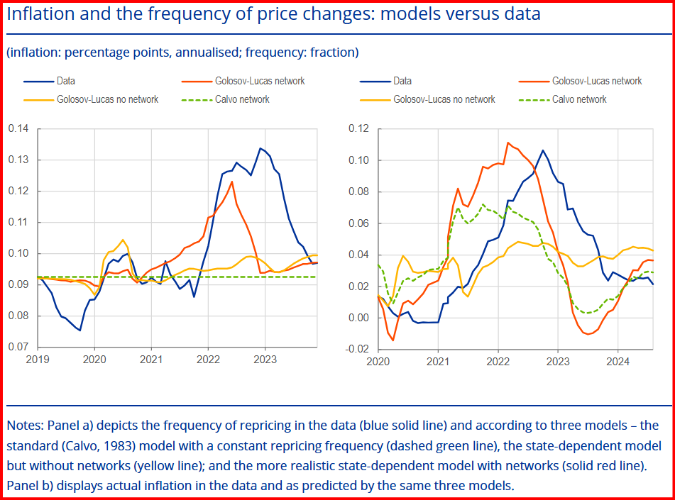
Pricing cascades – it never rains but it pours
Supply shocks are a very different story. Assuming constant demand, when the cost of a crucial input increases substantially, as occurred with energy prices after the Russian invasion of Ukraine, it triggers a pricing cascade. Many firms in other sectors are incentivised to reprice at the same time, with some prices feeding back as higher input costs to the original sector. This induces firms in the original sector to raise prices even more, leading to a sharp and rapid inflationary surge and a drop in real output.
ECB · RESEARCH BULLETIN NO. 139 27/01/26

Slide 10
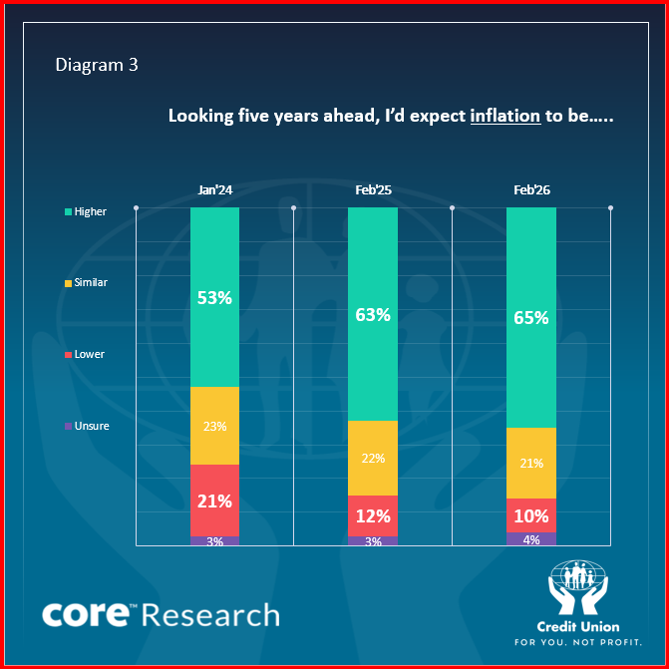
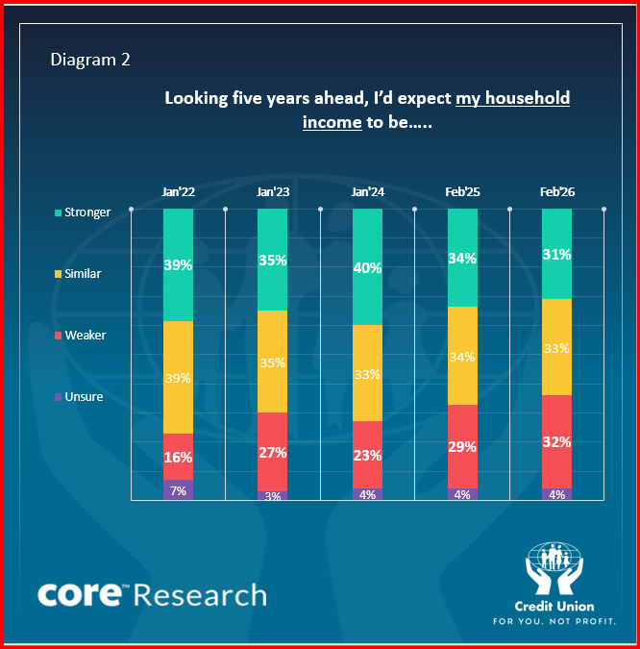
Irish consumers see their economic tomorrow much like today:
Inflation is expected to remain problematic while views are mixed on income prospects.
Two in three consumers see inflation higher in five years time
just one in ten see it lower
A three- speed consumer economy;
Household finances getting better, getting worse and muddling along

Slide 11
Summary
A noisy, nasty, and mainly negative world but….
Irish economy remains relatively strong…. At least for now
Population and jobs growth slower but still solid and key drivers of demand
Uncertainty making many Irish consumers nervous and mainly risk-adverse
Consumer sentiment, spending power and circumstances all vary hugely
Consumer spend growth circa 2-3% but feeling cooler amid sectoral differences
Inflation (varying) circa 2.5% but feeling hotter with wide variations
What form will the next ‘shock’ take?

