Slide 1
Enterprise Ireland’s Export Outlook
Marketing Society, March 2026
Conor O’Donovan

Slide 2

Our Strategy – Accelerate Sustainable Irish Business to
Start
Compete
Scale
Connect
Support start-ups with long-term,
sustainable growth ambitions
Strengthen productivity, competitiveness, resilience & sustainability
Increase the number of world-leading Irish companies
Enhance enterprise linkages and the innovation ecosystem

Slide 3
Some of the Remarkable Scale Up Companies we work with
Cloud-based software for employee recognition and performance
Cisco, LinkedIn, Procter & Gamble
Provides at-home health testing kits connected to regulated lab services.
American Airlines, British Airways, Fortune 500 companies (corporate wellness).
Supplies revenue-based financing and analytics for e-commerce businesses.
Wild (sustainable products), Shopify (merchant ecosystem)
Automates repetitive cybersecurity workflows with a no-code platform for security teams
Global leader in clinical trials
Regulatory compliance and client data management software for financial institutions.
Bank of China, Credit Suisse, UBS
Delivers online ordering and management solutions for restaurants.
Supports chains like White Castle (online ordering in the U.S.)
Facilitates cross-border B2B payments in over 200 countries and 140+ currencies
World leader in aerosol drug delivery

Slide 4

Record level of exports
97% increase
Since 2014
+7%
€36.75bn
Total Exports
€18.63bn
2014
€36.75bn
2024

Slide 5

Client Exports 2024
Total Exports €36.75bn
Nordics
€2.11bn
UK
€10.52bn
+24%
Eurozone Countries
€9.42bn
+4%
+10%
North America
€7.30bn
Europe
€10.63bn
+8%
+8%
Asia Pacific
€2.25bn
India/M.East/Africa
€1.59bn
+1%
+3%
Latin America
€0.38bn
+10%
Unspecified & Sales to Ornua
€1.97bn
+5%

Slide 6



Europe – Now Largest Export Territory
€10.63bn
29% of
€5.45bn
Europe Exports
up 8%
Total Exports
Non-Food Exports
up by 9%
€5.18bn
€3.65bn
€1.80bn
Food up 7%
Industrial & Lifesciences up 11%
Technology & Services up 7%

Slide 7

Eurozone
Germany
€2.65bn
Up 13%
Netherlands
€2.0bn
Up 13%
France
€1.82bn
Up 3%

Slide 8
UK - 2nd Largest Export Territory
€10.52bn
29% of
€5.38bn
UK Exports
Total Exports
Non-Food Exports
up 4%
up by 2%
€5.14bn
€3.26bn
€2.12bn
Food
Industrial & Lifesciences
Technology & Services
up 7%
down 1%
up 7%

Slide 9
North America - 3rd Largest Export Territory
€7.30bn
20% of
€6.66bn
North America Exports
Total Exports
Exports to USA
up 8%
up 8%
€5.61bn
€3.13bn
€2.48bn
Non-food exports
Technology & Services
Industrial & Lifesciences
up 9%
up 7%
up 11%

Slide 10




Exports by sector 2024 - €36.75bn
€9.05bn
+7%
€11.46bn
+9%
€16.25bn
+5%
Technology & Services
Industrial & Life Sciences
Food & Sustainability
including
including
including
Digital Technology
€3.16bn
High Tech Construction & Housing
Dairy: Drinks & Food FDI
€9.12bn
€4.66bn
+9%
+20%
+8%
Fintech, Financial
& Business Services
€2.90bn
Life Sciences
€3.36bn
Primary Meats & Food Technology
€4.74bn
+5%
+5%
+1%
Retail; Consumer & Online
€1.54bn
Engineering
€2.45bn
Prepared Consumer Foods; Seafood & Horticulture
€1.86bn
+6%
+2%
+2%
International Education, Ed Tech & Professional Services
Materials: Print & Packaging
€0.98bn
Climate, Sustainability and Agritech
€1.45bn
-4%
€0.53bn
+10%
+20%

Slide 11







Clients Top Business Challenges
Recruitment & Retention
Cost of doing business / inflation
Generating new business
Access to Finance
Economic/Political Climate & Tariffs
Access to new markets

Slide 12




Megatrends
Deglobalisation
Digitalisation
Demographic Change
Decarbonisation & climate change

Slide 13

Global Trade Outlook 2026
2026 Outlook
Disruption & fragmentation
Localisation
Resilience -higher inventory; flexible, diversified supply chains to manage disruption
Market Diversification
Resource scarcity – copper, critical rare earth minerals, water

Slide 14
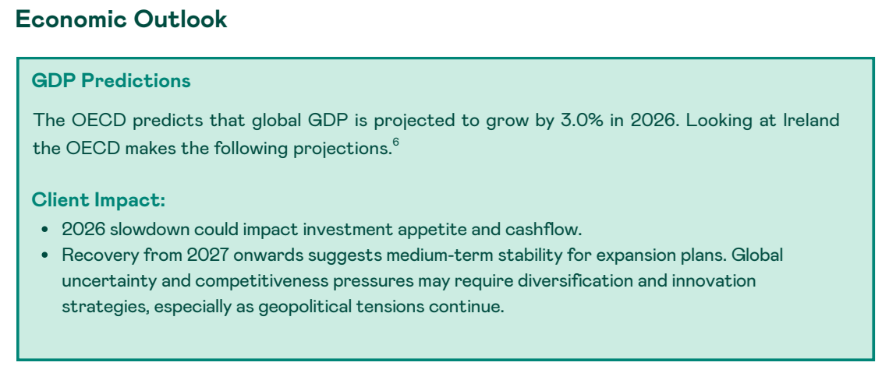
National Outlook

Slide 15





Enterprise Ireland Client Investments
€115m
€18m
€12.5m
€6m
€3m
investment
investment
investment
investment
investment

Slide 16

Version 1 opens new Dublin HQ, adds 250 local jobs

Slide 17

Media Coverage

Slide 18

Media Coverage

